Slide 1
Expansion of the Guided Data
Capture and ThermoML to Metallic-based Systems
Boris Wilthan, Vladimir Diky, Ken Kroenlein
Thermodynamics Research Center
NIST Diffusion/CALPHAD Data Informatics and Tools Workshop May 14, 2015

Slide 2
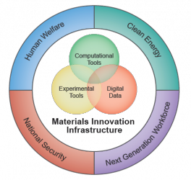
Materials Genome Initiative
Given NIST expertise in the integration, curation, and provisioning of critically evaluated data, NIST has assumed a leadership role within MGI.
…is establishing essential data exchange protocols and the means to ensure the quality of materials data and models
MGI_strategic_plan-dec_2014

Slide 3
Background to what we do within the NIST Thermodynamics Research Center
Goal/Mission: Provide critically evaluated thermophysical and thermochemical property values of chemicals, mixtures, and metal systems for use by industry, academia, and other government agencies for…
  Process development & optimization (including essentially all separation processes; distillation, crystallization, extraction, metal processes)
  Fundamental research into molecular properties and phase diagrams (e.g., benchmark values for computational chemistry)
  Regulatory decisions
  Industrial applications (custody transfer, equipment validation, …)
  Many others

Slide 4
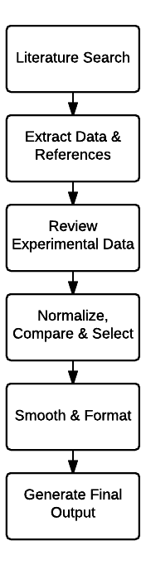
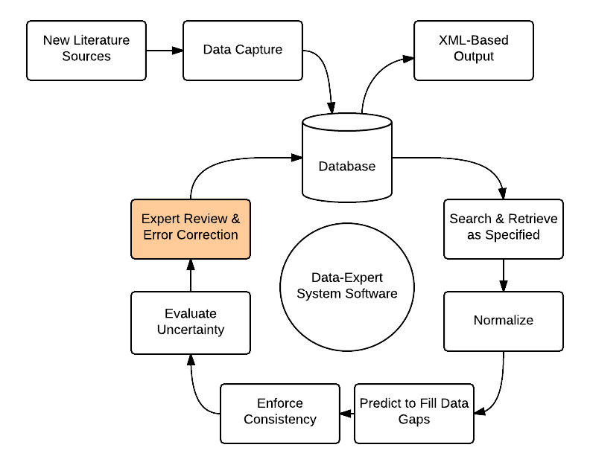
Data evaluation cycle
Static
Dynamic
Notes:
Static: Very long turn-around, Who chooses what to evaluate, Short “shelf life” – no new data
Dynamic:

Slide 5
Data growth is exponential
Annual growth of data in thermophysical properties of small molecular organics has been near 6 % per year for 200 years
  Doubles every 12 years
Shorter term has been trending upward, with 7 % growth for the last 20 years
  Doubles every 10 years
Across all data collection in science, 4.7 % per year
  Doubles every 15 years
  Larsen and von Ins Scientometrics 2010, 84, 575-603

Slide 6
Scope of the Experimental Data Considered
Essentially all thermodynamic and transport properties are considered
  Thermodynamic: densities, vapor pressures, heat capacities, critical properties, phase-transition properties, enthalpies, sound speed, etc.
  Phase Equilibria: vapor-liquid, liquid-liquid, solid-liquid, solid-solid
    VLE (pTxy, pTx, Txy, etc.), LLE, SLE, solubilities, etc.
  Transport: viscosities, thermal conductivities, electrical resistivities, etc.
  Optical: emissivities in liquid state
  Properties in gas, liquid, crystal, glasses, multiphase equilbrium, etc.
Properties of reactions are included (combustion & solution calorimetry)
Properties of mostly organic and organic-like compounds with unique molecular and elemental composition, and no overall charge are considered (at this time)
This means…
  no polymers
  no properties of ions (i.e., acid dissociation constants)
  no biological systems (i.e., binding constants, protein folding transitions, etc.)
  no clathrates (i.e., materials that do not have unique elemental compositions)
  no optical properties of solid metals
  no mechanical properties
  yes for properties of ionic liquids, salt solutions, etc.

Slide 7
Scope of the Experimental Data Considered
Activity coefficient | Entropy of reaction | Internal energy of reaction (mole basis) | Refractive index (other wavelength)
Activity | Equilibrium constant - molarity basis | Internal energy of reaction at constant volume (mass basis) | Relative linear expansion
Adiabatic compressibility | Equilibrium constant - mole fraction basis | Isobaric coefficient of volume expansion | Relative magnetic permeability
Apparent enthalpy | Equilibrium constant - pressure basis | Isothermal compressibility | Relative partial molar enthalpy
Apparent entropy | Eutectic composition: mole fraction | Joule-Thomson coefficient | Relative partial molar entropy
Apparent Gibbs energy | Eutectic composition: weight fraction | Kinematic viscosity | Relative partial molar Gibbs energy
Apparent molar heat capacity | Eutectic temperature | Langmuir surface area | Relative partial molar heat capacity
Apparent molar volume | Excess enthalpy | Lattice energy at 0 K | Relative partial molar volume of
Binary diffusion coefficient | Excess entropy | Linear expansion coefficient | Self diffusion coefficient
Boiling temperature | Excess Gibbs energy | Magnetic permeability | Specific density
Boiling temperature | Excess heat capacity | Molar density | Specific volume
Compressibility factor | Excess virial coefficient | Molar Enthalpy Change | Speed of sound
Cp/e(hemispherical total) | Excess volume | Mole fraction | Standard state enthalpy
Critical compressibility factor | Fluidity | Monotectic composition: mole fraction | Standard state entropy
Critical density | Fugacity coefficient | Monotectic composition: weight fraction | Standard state Gibbs energy
Critical molar volume | Fugacity | Monotectic temperature | Standard state heat capacity
Critical pressure | Gibbs energy | Normal boiling temperature | Surface tension liquid-gas
Critical specific volume | Gibbs energy function {G(T)-H(0)}/T | Normal emittance | Thermal conductivity
Critical temperature | Gibbs energy of reaction | Normal melting temperature | Thermal diffusivity
Electrical conductivity | Heat capacity at constant pressure Cp | Number of phases | Thermal pressure coefficient
Electrical resistivity | Heat capacity at constant pressure Cp per unit volume | Partial molar enthalpy | Thermodynamic equilibrium constant
Electrical resistivity at reference geometry | Heat capacity at constant volume Cv | Partial molar entropy | Tracer diffusion coefficient
Enthalpy | Heat capacity at constant volume Cv per unit mass | Partial molar Gibbs energy | Triple point pressure
Enthalpy Change | Heat capacity at constant volume Cv per unit volume | Partial molar heat capacity | Triple point temperature
Enthalpy function {H(T)-H(0)}/T | Heat capacity at vapor saturation pressure Csat | Partial molar volume | Vapor or sublimation pressure
Enthalpy of mixing of a binary solvent with component | Heat capacity ratio Cp/Cv | Partial Pressure | Vapor or sublimation pressure
Enthalpy of reaction | Helmholtz energy | Phase transition temperature | Viscosity
Enthalpy of solution | Hemispherical emittance | Pore diameter | Volume fraction
Enthalpy of transition or fusion | Interfacial tension | Pore volume | Volume fraction of phase
Enthalpy of vaporization or sublimation | Internal energy | Pressure coefficient of enthalpy | Weight fraction
Entropy |  | Radiance temperature

Slide 8
Scope of the Experimental Data Considered
Al-Si
Al-Mg
Al-Mg-Si
Mg-Si
Al | Si | Mg
Fe | Ni | Cr
Co | Mo | Ti

Slide 9
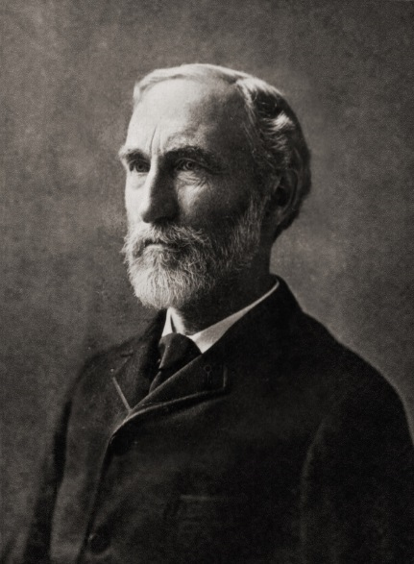
Data constraints
Gibbs’ Phase Rule
…by what data is given
by the author
T_{φ1} | = | T_{φ2} | = | … | = | T_{φP}
p_{φ1} | = | p_{φ2} | = | … | = | p_{φP}
μ_{1, φ1} | = | μ_{1, φ2} | = | … | = | μ_{1, φP}
μ_{2, φ1} | = | μ_{2, φ2} | = | … | = | μ_{2, φP}
 |  |  | ⁞
μ_{C, φ1} | = | μ_{C, φ2} | = | … | = | μ_{C, φP}
μ_{i, φj} = f(T_{φj}, p_{φj}, x_{1, φj}, x_{2, φj}, … x_{C-1, φj})
What is missing often?
Purity information
%: wt% or at%
Pressure (vacuum)
Temperature and time
Uncertainties
F = (C+1)P – (C+2)(P–1)
= C – P + 2

Slide 10
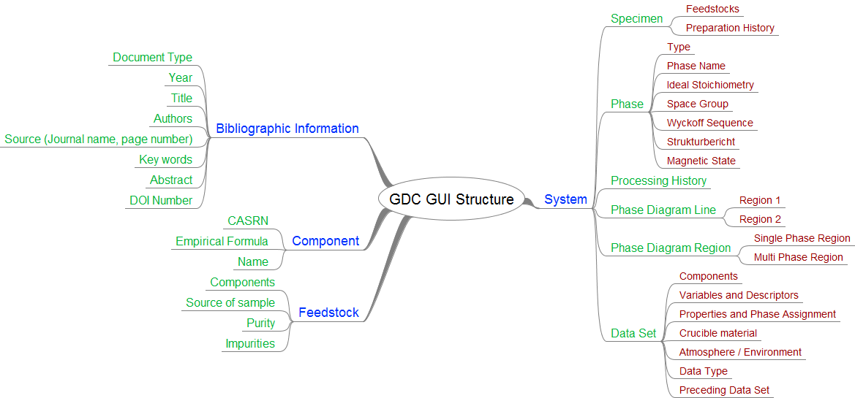
GDC structure summary

Slide 11
Design elements
Mimic structure of presented data
Separation of data and interpretation
Metadata
No free text fields
Phase identification
Every property has an uncertainty

Slide 12
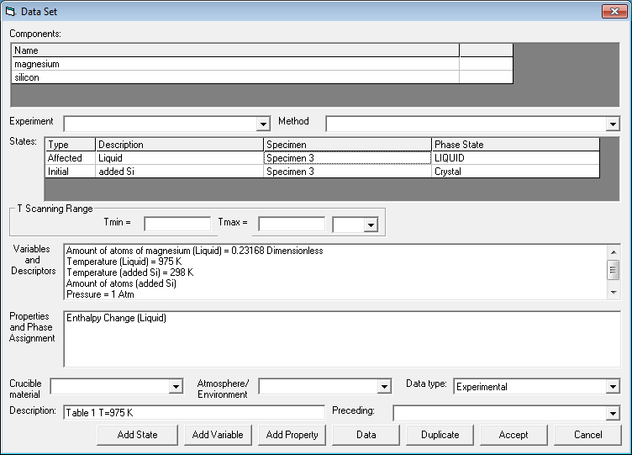
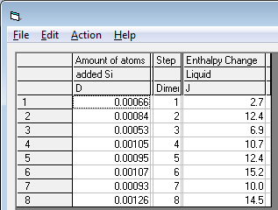
Mimic structure of presented data

Slide 13
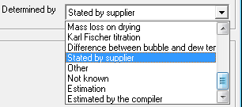
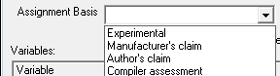
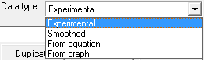
Separation of data and interpretation
For:
Phase identification
Purity
Data type

Slide 14
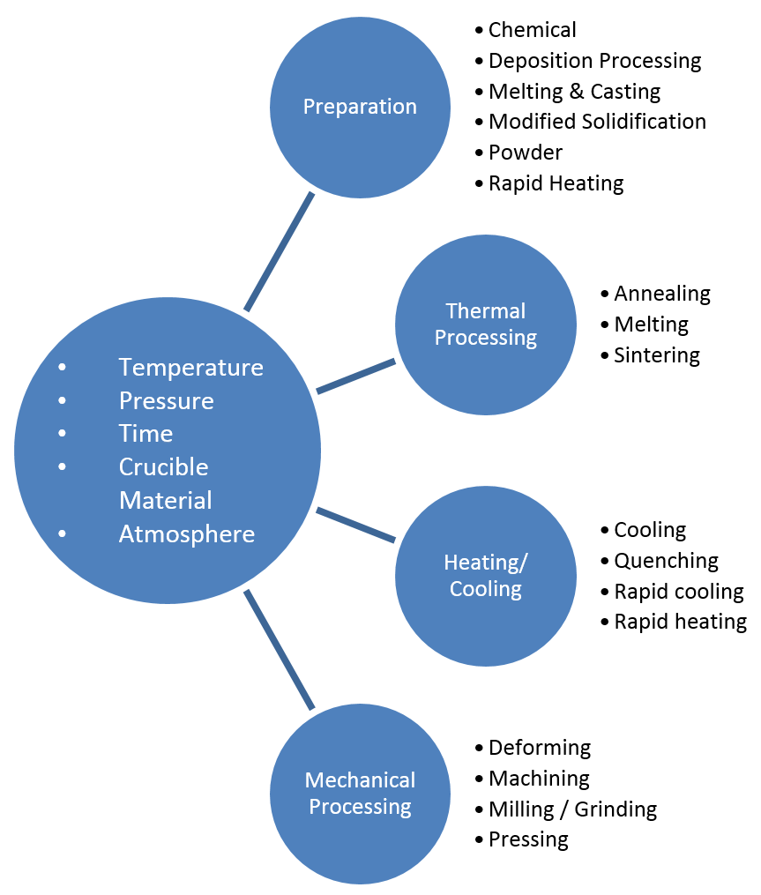
Metadata - Processing history
Operation | Method | Detail
Preparation | Melting & Casting | Arc Melting Casting Induction Melting Radiation/Furnace Melting Vacuum Degasing
Thermal Processing | Annealing | Precipitation Annealing Relaxation Annealing Solution Annealing
 | Sintering | Laser Sintering Radiation Sintering (Furnace) Resistance Sintering Spark Plasma Sintering
Processing
history
Temperature
Pressure
Time
% Reduction
Crucible Material
Atmosphere

Slide 15
Metadata - Processing history
Thermal Processing
Melting & Casting
Heat Treatment
Sintering
Cooling/Heating Methods
Cooling
Quenching
Rapid Cooling
Milling
Preparation
Melting & Casting
Deposition Processing
Rapid Heating
Pressing
Machining
Acoustic Wave
Chemical
Powder
Deforming
Mechanical Possessing
Modified Solidification
Modified Solidification
Rapid Cooling
Operation
Method
Operation | Method | Detail
Preparation | Melting & Casting | Arc Melting Casting Induction Melting Radiation/Furnace Melting Vacuum Degasing
Thermal Processing | Annealing | Precipitation Annealing Relaxation Annealing Solution Annealing
 | Sintering | Laser Sintering Radiation Sintering (Furnace) Resistance Sintering Spark Plasma Sintering
Temperature
Pressure
Time
% Reduction
Crucible Material
Atmosphere

Slide 16
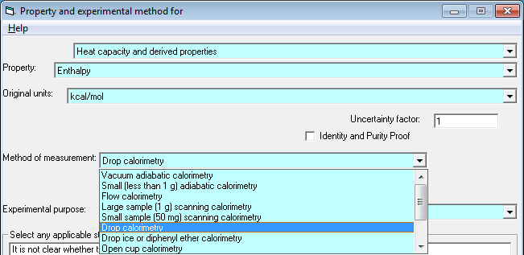
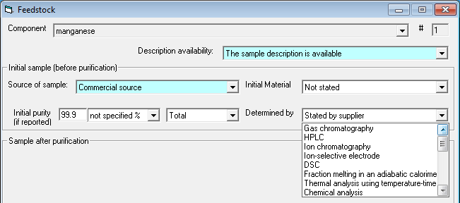
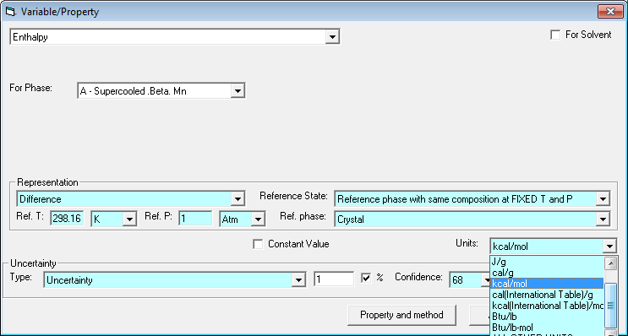
No free text fields

Slide 17
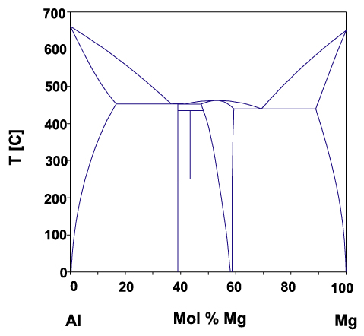
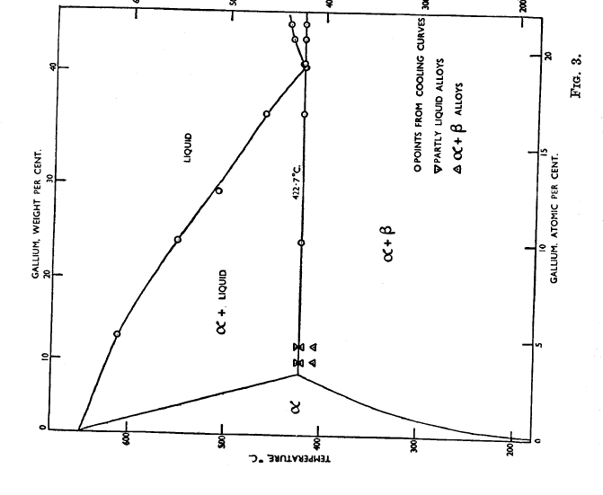
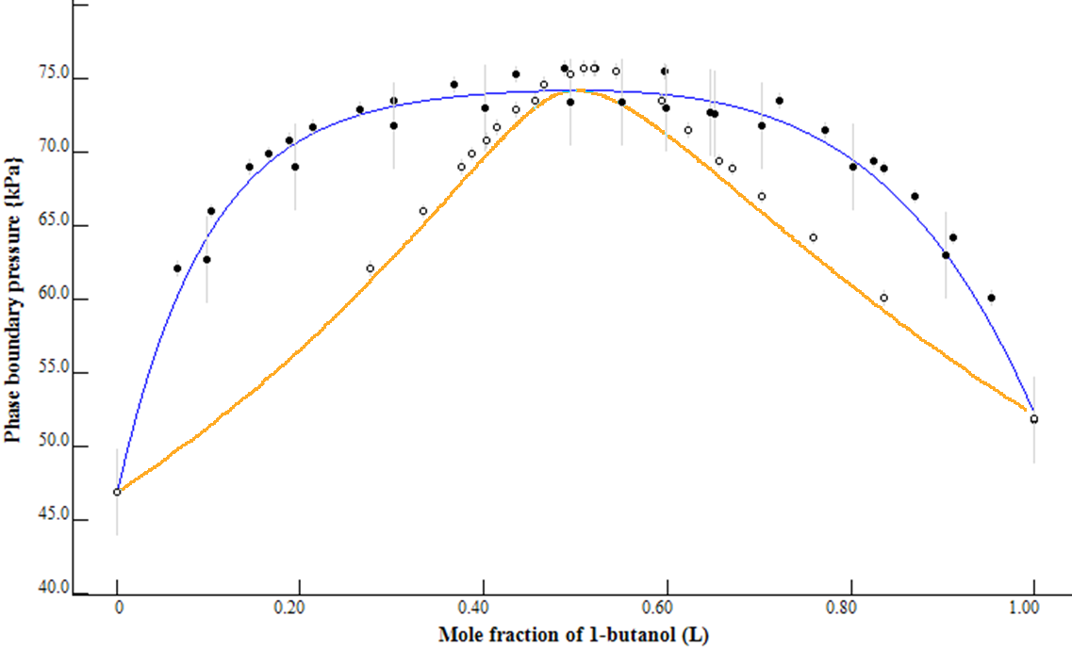
Design elements – Phase identification

Slide 18
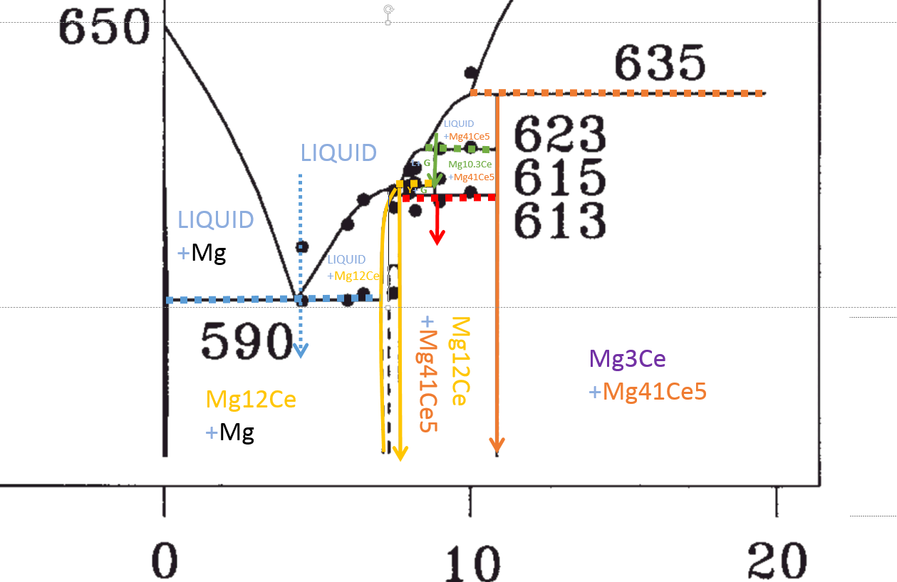
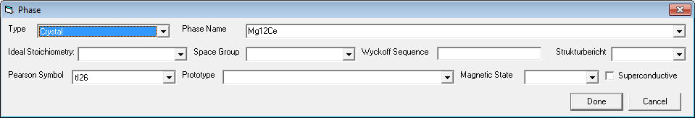
Design elements – Phase identification

Slide 19
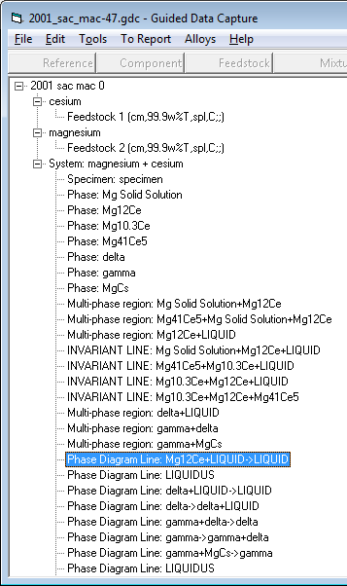
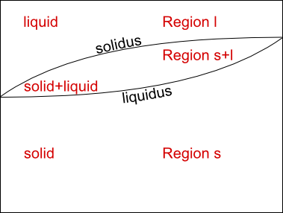
Design elements – Phase identification

Slide 20
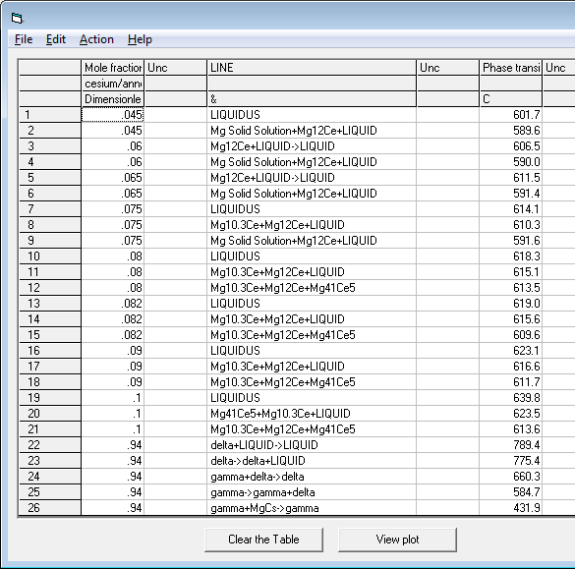
Design elements – Phase identification

Slide 21
Design elements – Uncertainties
Repeat-ability
Typographical error
Copy/Paste
Inconsistent and anomalous data
Missing information
(Units, variables)
Calibration/ Comparison
Methode/
Device
Expert judgment
Device Specs
Uncertainty
for each data point
StdDev
Unc.
Budget

Slide 22
Outlook
Implementing of new dissemination channels
  Export to pop-files is already implemented
ThermoML extension for Metals/Alloys
  Description of alloy-specific phases
  Extending enumeration lists (properties, methods)
  Relations between states
  Additional attributes of variables/properties
Expanded data coverage

Slide 23
Questions

