Slide 1

NIST Multi-Domain Knowledge Planes for Service Federation for 5G & Beyond Public Working Group (MDKP-PWG) Kick-Off
Knowledge Plane (KP) Concept & KP-to-KP Federations, Autonomic/Autonomous Networks (ANs)
Knowledge Planes Driven AGILE Service Federation for 5G & Beyond
22nd June 2023
Presenters : Ranganai Chaparadza, PhD: Capgemini Egineering; IPv6 Forum Research Fellow

Slide 2
Outlook
Autonomic/Autonomous Networking (ANs) and Standards
Knowledge Plane (KP) Concept: What are Knowledge Planes (KPs)?
The Era of Knowledge Plane (KP) Platforms Driven Networking—Anchor for Federation of Autonomic/Autonomous Networks (ANs) Across Industry Sectors
The Knowledge Plane (KP) Concept is defined in ETSI TS 103 195-2 as adopted from the original KP concept defined by the MIT (USA) SIGCOMM’03 AMC paper (David D. Clark, et al: “A Knowledge Plane for the Internet” ) and enhanced as:
→ a construct that exhibits cognitive capabilities and behaviours in performing the management and control of networks and services, and operates on network-wide views (including knowledge continuously gathered about the state and behaviours of network elements/functions) to dynamically program (configure) network resources and parameters, and adaptively and autonomically make changes to the network and services compositions and configurations in order to meet the objectives (e.g. business objectives) desired for the whole network in the best optimal way.
2
2

Slide 3
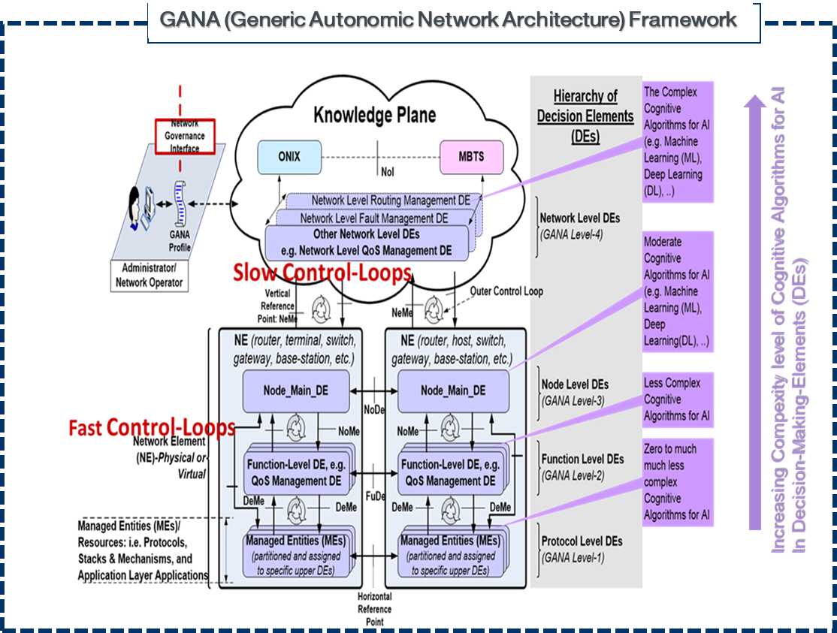
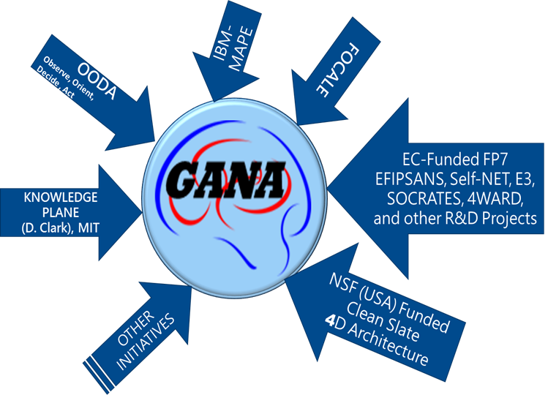
ETSI GANA (Generic Autonomic Networking Architecture)
Reference Model / Functional Architecture (ETSI TS 103 195-2) for Multi-Layer AI/ML & AMC
GANA is Framework for Multi-Layer Autonomic Management & Control (AMC)/Autonomics & Multi-Layer AI/ML for AMC
Remark: ETSI White Paper No.16 and ETSI TS 103 195-2 describe the Recommendation to focus on GANA levels 2 to 4 when introducing autonomics in architectures and Why

Slide 4

Intents Handling & Addressing Stability of Control-Loops in GANA:
Design for Stability Principles and Run-Time Stability Principles for Coordination / Synchronization / Orchestration among DEs
One of the Principles for Addressing Stability specified in GANA (DE-to-DE Coordination)
Intent translated
into Goals and
Policies.
It resolves cnflicts
Intent Specification (Should be provided as input to the GANA Knowledge Plane (KP) primarily rather than at NE level) by the CSP
Governance Interface
CSP
Each DE can be designed to derive and compute from Intent, Goals
and Policies Intended for its scope
GANA Knowledge Plane Level AutoDiscovery_&_AutoConfiguration-DE
(GANA_KP –DE / AI Model)
Superior/Designated cDE
GANA Knowledge Plane Level
Security-Management-DE
(ODA_KP-Sec Mgt DE / AI Model)
1) Act as Orchestrator Role
besides Coordinator
2) Employ Optimisation Algorithm
To ordering of certain Actions or Plans of Actions computed by the DEs it coordinates, before DEs are allowed to execute the Actions
DE-to-DE
Coordination
GANA_KP Level DE « x » e.g. Mobility-Management-DE
GANA_KP Level DE « z »
e.g. Routing-Management-DE
DE-to-DE Collaboration in form of a Chereography, by exchange of information and or negotiations on parameter values adjustments on the policies they enforce in order to achieve the High Level (e.g. ODA Level) Global Autonomics and AI Objective
GANA_KP Level DE « y »
e.g. QoS-Management-DE

Slide 5
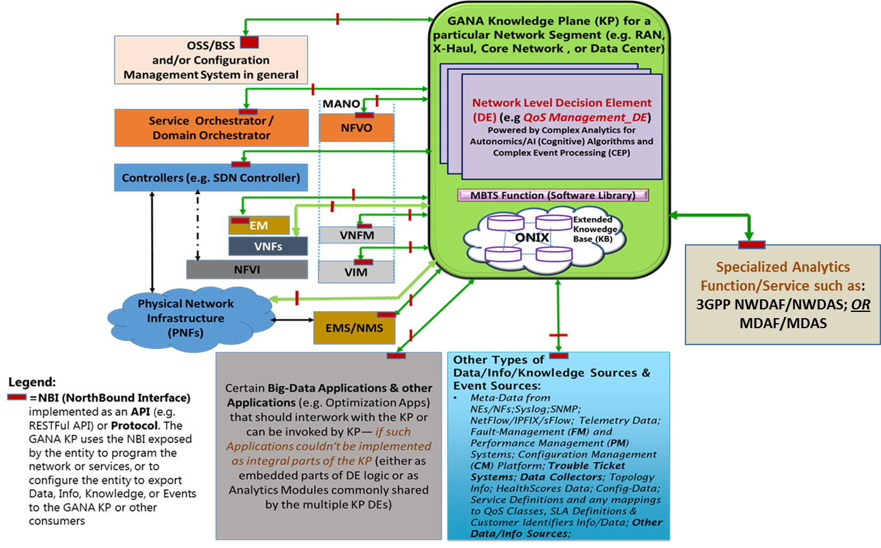
ETSI GANA Knowledge Plane (KP) Platform Integration with other Systems
Service Federation Orchestration & Management Platform
GANA KP_x
What the NIST MDKP-PWG should work on:
Generic Architecture Framework
Types of GANA KPs and Integration Interfaces Scope for specific KPs (Selected KPs and Selected Scope)
Requirements for Knowledge Plane (KP) Platforms Driven Networking (including KP Governance and KP-to-KP Federations)
APIs for GANA KP Integrations with other systems
Application of Zero Trust Principles in GANA KP Federations
Liaisons with some SDOs/Fora Group
ETSI TR 103 747
Has Insights
Remark: The NBI APIs indicated should be specified and Standardized if no standards exist, including KP-to-KP Federation Reference Points. → Implies a Call for Action for Joint efforts by Standards SDOs/Fora
5
5

Slide 6
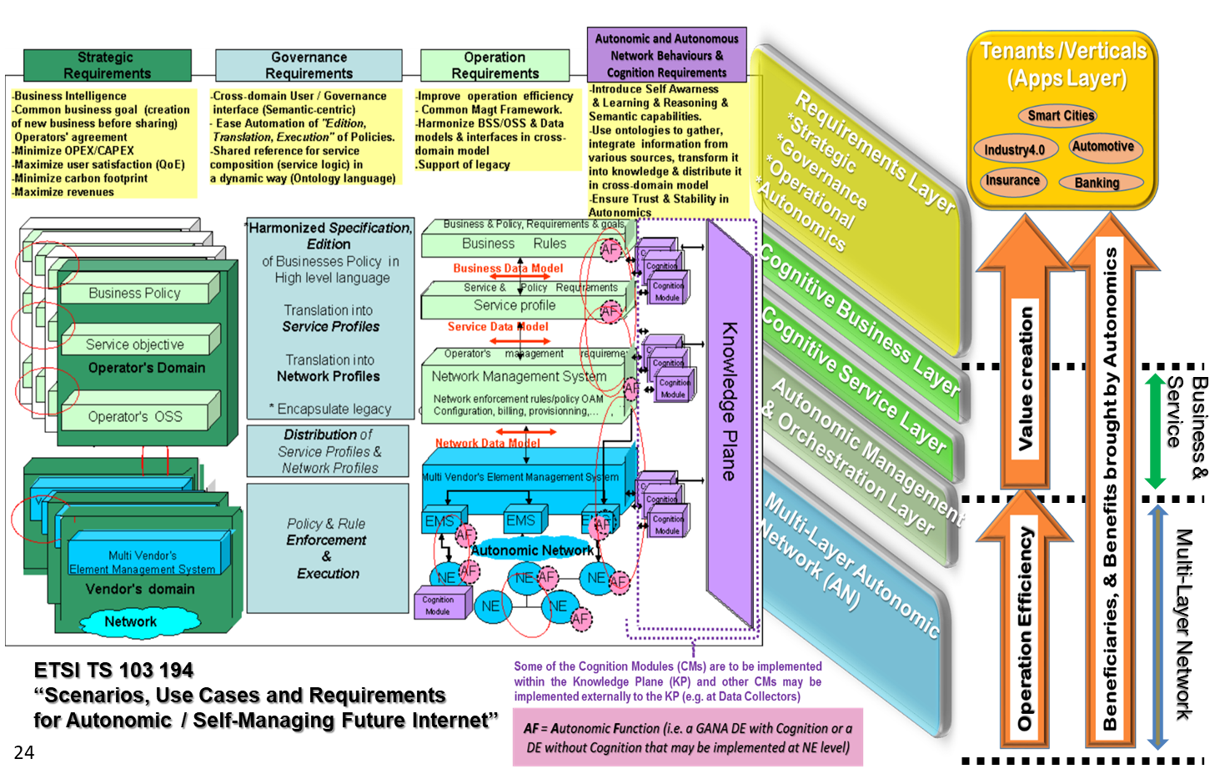
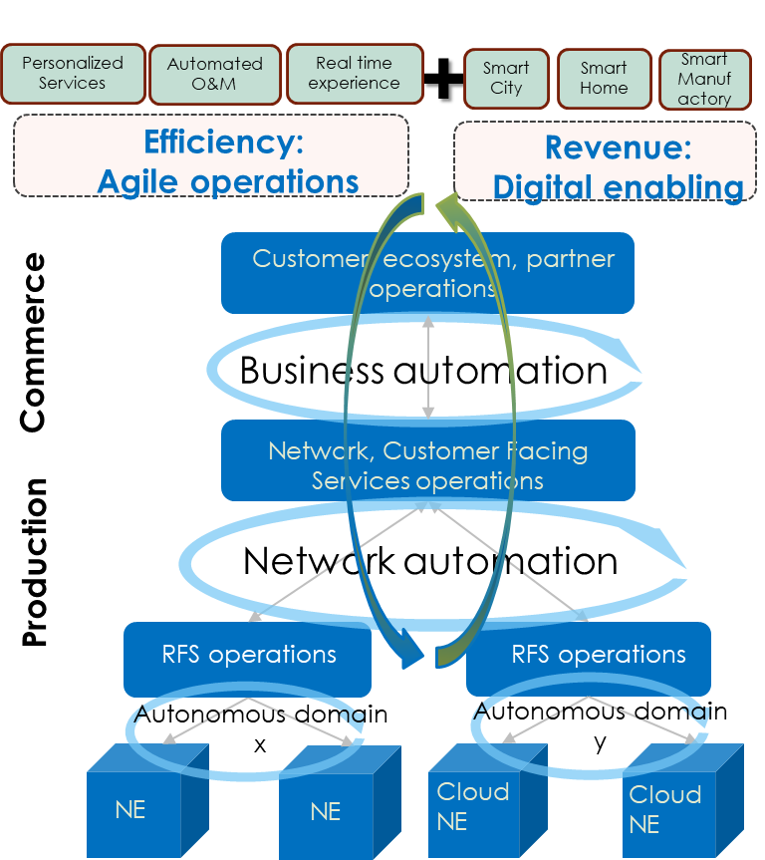
ETSI GANA Framework alignment with TMForum Autonomous Networks (ANs) Framework (comparison performed during TC INT#44, Sept 4th 2019, Paris).
GANA Scenarios, Use Cases & Requirements
TMForum Autonomous Network Framework
Aligned with TMForum AN Framework
ADD SECTION NAME
ETSI GANA Framework and TMForum ODA & AN Framework are aligned

Slide 7
KP to KP Federations

Slide 8
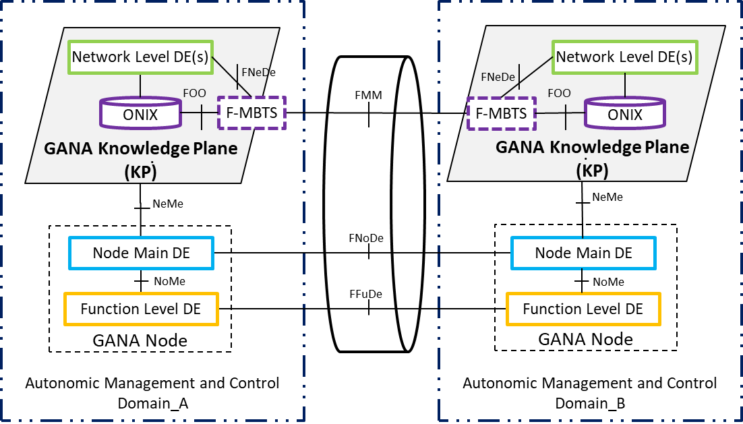
Federation of GANA Knowledge Planes (KPs) Framework
(ETSI TS 103 195-2)
NeMe
The Protocols and APIs Required. Joint efforts needed to define

Slide 9
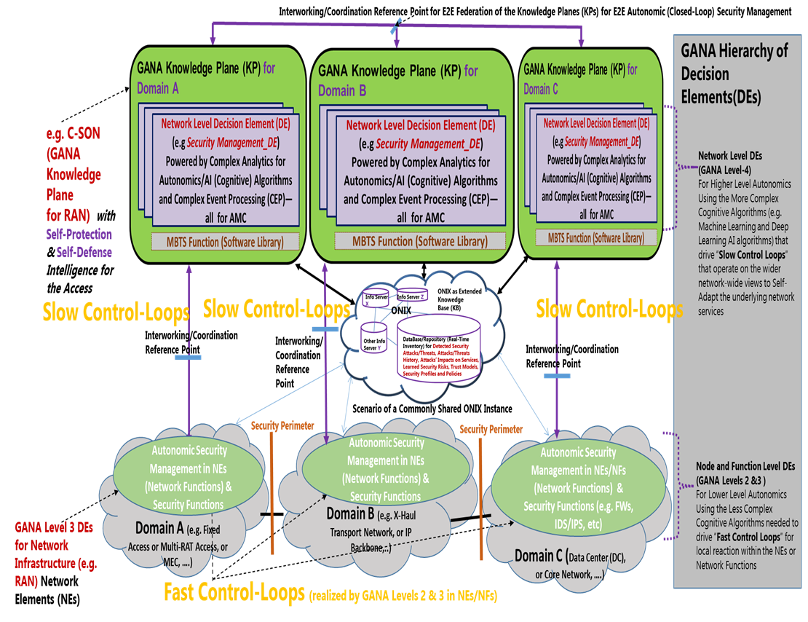
Federation of GANA Knowledge Planes (KPs), e.g. for E2E Autonomic (Closed-Loop) Service & Security Assurance of 5G Slices – Horizontal Federation of KPs

Slide 10
Federation of GANA Knowledge Planes (KPs), e.g. for E2E Autonomic (Closed-Loop) Service & Security Assurance of 5G Slices– Vertical (Hierarchical) Federation of KPs

Slide 11
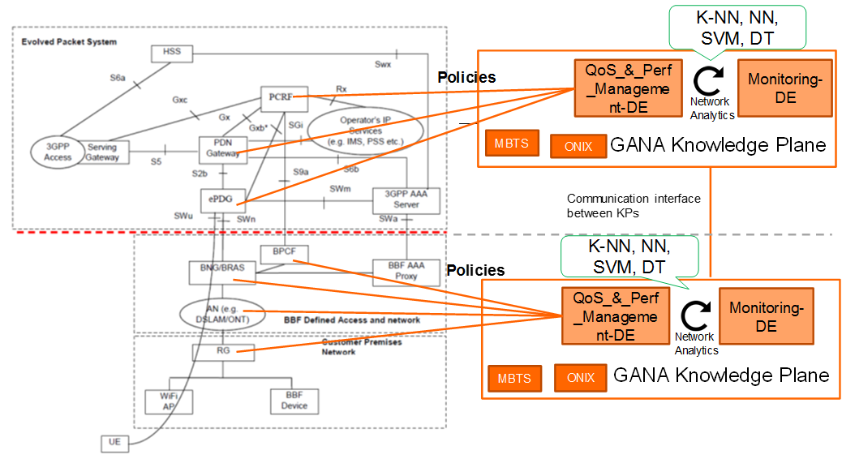
Federated/Interworking GANA Knowledge Planes (KPs) for BBF (BroadBand Forum) Domain and 3GPP Domain (ETSI TR 103 473 V1.1.2)
ETSI TR 103 473 V1.1.2

Slide 12

ETSI GANA Model Adoption in NGMN’s Autonomic Networking Requirements in E2E 5G Architectures, and ETSI Implementation Fmwk
ETSI has published
ETSI TR 103 747 on Implementing Federated GANA Knowledge Planes (KPs) Platforms for E2E Multi-Domain Federated Autonomic Management and Control (AMC) of Slices in NGMN E2E 5G Architecture
12
© ETSI 2012. All rights reserved

Slide 13
ETSI GANA Model Adoption in NGMN’s Autonomic Networking Requirements in E2E 5G Architectures, and ETSI Implementation Fmwk
ETSI has published
ETSI TR 103 747 on Implementing Federated GANA Knowledge Planes (KPs) Platforms for E2E Multi-Domain Federated Autonomic Management and Control (AMC) of Slices in NGMN E2E 5G Architecture
13
© ETSI 2012. All rights reserved

Slide 14
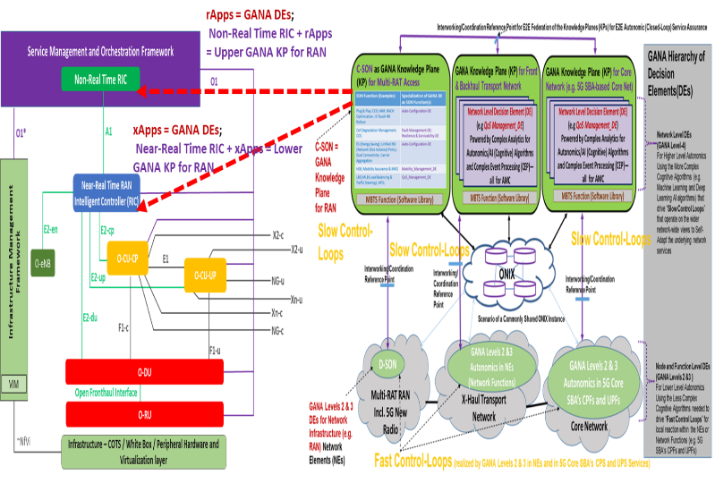
GANA KP, SON; O-RAN RICs/xApps/rAPPs: Federations for E2E Self-* are Needed

Slide 15
ETSI GANA Model Adoption in BroadBand Forum (BBF)’s AIM Framework
15
© ETSI 2012. All rights reserved

Slide 16
GANA DE Design in BroadBand Forum (BBF)’s AIM Framework, using ITU-T Y.3172
16
© ETSI 2012. All rights reserved

Slide 17

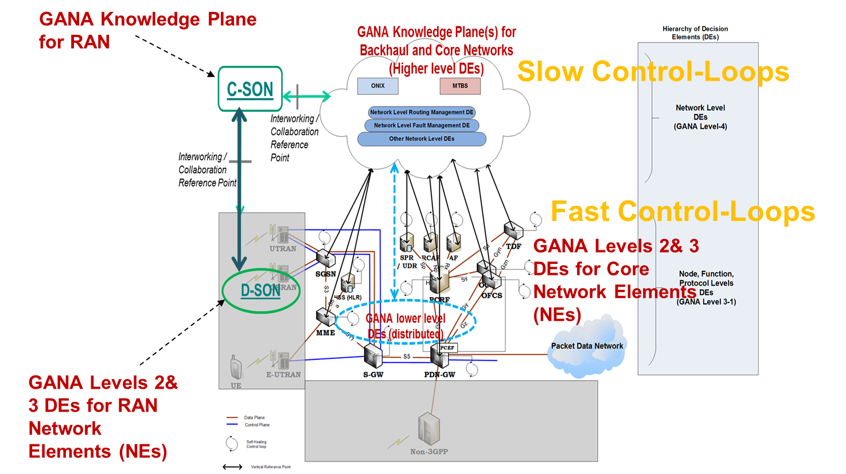
Example of a GANA Instantiation onto a particular Network Architecture and its associated Management & Control Architecture
Instantiation of GANA onto 3GPP EPC Core & Backhaul Network (ETSI TR 103 404); and Federated/Interworking GANA Knowledge Planes for RAN-, Backhaul- and 3GPP EPC Core Networks complemented by low level autonomics

Slide 18
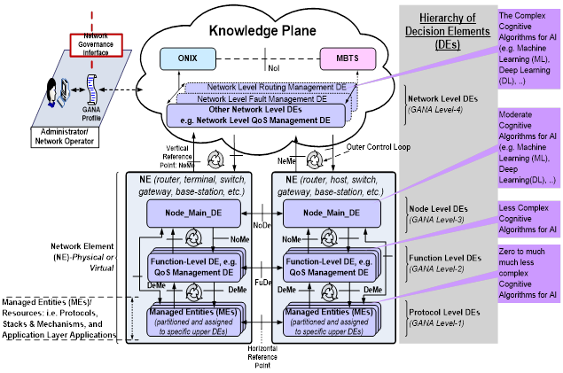
Hybrid-SON Model Mappings to the ETSI GANA Model (PoC on Autonomics in 5G Slices Service Assurance)
NOTE: Hybrid SON Model as specified by NGMN is compatible with GANA
  Hybrid SON (C-SON(Centralized SON) & DSON(Distributed SON)) are considered as an implementation of the GANA Model for the RAN
GANA for the RAN is realized by Hybrid SON (C-SON (cognitive) complemented by D-SON in eNBs)
SON Function = GANA Decision Element (DE)
C-SON with Cognitive SON Functions = GANA Knowledge Plane for the RAN
https://intwiki.etsi.org/images/ETSI_GANA_in_5G_PoC_White_Paper_No_1_v1.28.pdf

Slide 19
Introduction to MDKP-PWG Deliverables
MDKP-PWG Deliverables & Planning
19
19

Slide 20
Introduction to Deliverables
Produce a Generic Architecture Framework Blueprint (GAFB) that articulates the role GANA Knowledge Planes (KPs) Platforms should play as Anchors for the Federation of Autonomic/Autonomous Networks (ANs): Early Draft September 15, 2023; Stable Draft December 31, 2023; Final Version February 2024
Describe Use Cases on the KP-to-KP Federations and on APIs for GANA KP Integrations: Early Draft October 1, 2023; Stable Draft July 31, 2024; Final Version September 2024
Describe Requirements for Knowledge Plane (KP) Platforms Driven Networking (including KP Governance and KP-to-KP Federations) within the GAFB: Early Draft November 2023; Stable Draft April 2024; Final Version September 2024
Discuss How Zero Trust Principles (ZTP) can be applied in GANA KP-to-KP Federations.
20
20

Slide 21
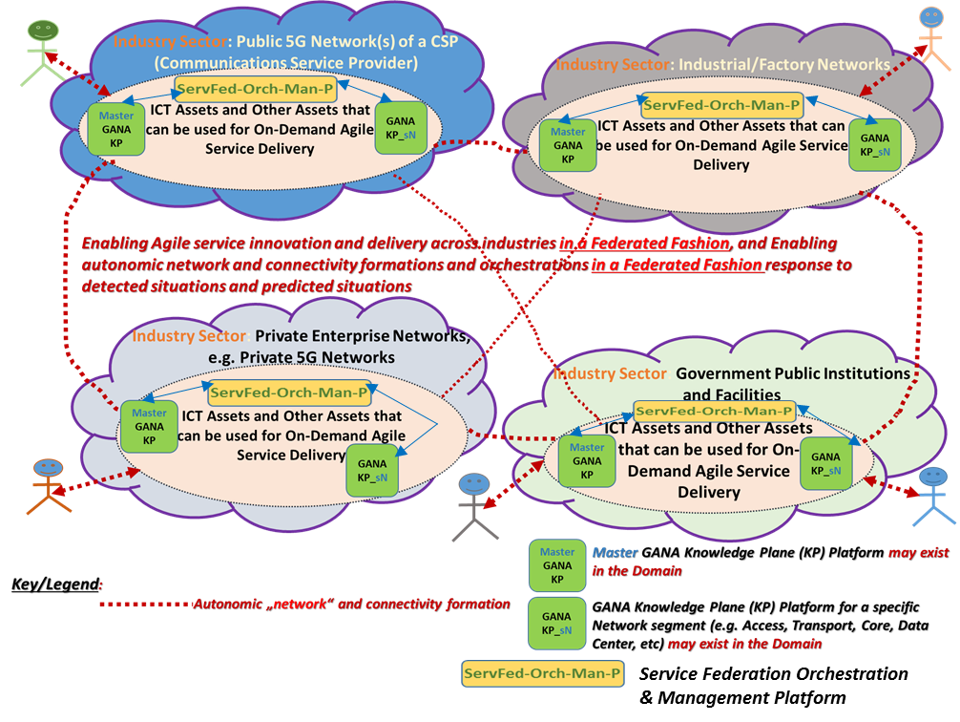
Generic Architecture Framework Blueprint (GAFB) that articulates the role GANA Knowledge Planes (KPs) Platforms should play as Anchors for the Federation of ANs
→ The NIST PWG will liaise with SDO/Fora such as ETSI, IEEE, ITU-T, NGMN, or other
21
21

Slide 22
ETSI GANA Knowledge Plane (KP) Platform Integration with other Systems
Service Federation Orchestration & Management Platform
GANA KP_x
What the NIST MDKP-PWG should work on:
Generic Architecture Framework
Types of GANA KPs and Integration Interfaces Scope for specific KPs (Selected KPs and Selected Scope)
Requirements for Knowledge Plane (KP) Platforms Driven Networking (including KP Governance and KP-to-KP Federations)
APIs for GANA KP Integrations with other systems
Application of Zero Trust Principles in GANA KP Federations
Liaisons with some SDOs/Fora Group
Remark: The NBI APIs indicated should be specified and Standardized if no standards exist, including KP-to-KP Federation Reference Points. → Implies a Call for Action for Joint efforts by Standards SDOs/Fora
ETSI TR 103 747
Has Insights
22
22

Slide 23
Two aspects of Autonomic Management and Control (AMC) Federations that need to be considered in deriving the Requirements for GANA KP-to-KP Federations
Requirements pertaining GANA KP-to-KP Federations we study include the role of GANA KPs federations in Composable Networks, Composable Services, Enablers such as Cloud Federations APIs, Autonomic Network Formations, How KPs Build Knowledge and can exchange Knowledge and negotiated operations/actions for Self-* AMC intelligence across federated ANs, e.g., Self-Optimizations, Self-Protection, Self-Diagnosis and Self-Healing, Self-Defense, etc.
Type-A Federation: Federations of GANA DEs’ Autonomics operations based on DE’s Autonomics Algorithms that may have been chosen to be implemented in a Distributed fashion (across NEs/NFs) such that the DEs involved collaborate to configure certain resources (Managed Entities (MEs)) in certain points in the network to achieve a network behaviour that can only be attained through the DEs’ collaborations or exchange of information for the benefit of a certain larger scope of the network and services delivered by the portion of the network involved
Type-B Federation: Federated AMC through GANA KPs across Administrative Domains that host various Technology Domains (such as Access Network, x-Haul Transport Network, Core Network, or Data Center Network) and associated GANA KPs. AMC federation at the level of the GANA KPs is likely to be the only level of AMC federations that may be required across Administrative Domains, e.g., across CSPs.
23
23

Slide 24
Overview of Requirements for Knowledge Plane (KP) Platforms Driven Networking—Anchor for Federation of Autonomic/Autonomous Networks (ANs) Across Industry Sectors
Requirements pertaining GANA KP-to-KP Federations we study include the role of GANA KPs federations in Composable Networks, Composable Services, Enablers such as Cloud Federations APIs, Autonomic Network Formations, How KPs Build Knowledge and can exchange Knowledge and negotiated operations/actions for Self-* AMC intelligence across federated ANs, e.g., Self-Optimizations, Self-Protection, Self-Diagnosis and Self-Healing, Self-Defense, etc.
Type-1 Requirements: KP support for the industry targeted COPAAN Blueprint’ Governance and Federations Interfaces and associated Primitives
Type-2 Requirements: KP support of Mechanisms for Auto-Discovery by other KPs in a secure and trusted fashion
Type-3 Requirements: KP support of Mechanisms that enable the KP to collaborate with other KPs by way of federations that involve the KPs working together to instantiate and orchestrate networking resources to create dynamically Composable Networks built using various technologies required to deliver services to humans and machines as may be needed on-demand, and with the KPs working together to destroy or delete the networks and or services when no longer needed.
Type-4 Requirements: KP support of Mechanisms that enable the KP to collaborate with other KPs by way of federations that involve the KPs working together to instantiate and orchestrate network services to create dynamically Composable Services using network resources or network instances that already exist and are under the management and control responsibility of their respective KPs.
Type-5 Requirements: KP support for Enablers for Federations such as Cloud Federations API defined by IEEE Std 2302™-2021 that was originally developed by NIST and was further developed into IEEE as a standard. Such APIs are more relevant for Type-B Federation.
Type-6 Requirements: KP role in Autonomic network and connectivity formations and orchestrations in response to detected situations and predicted situations, and/or agile service innovation and delivery across industries in a federated fashion
Type-7 Requirements: KP support for Mechanisms and Techniques for supporting Type-A Federation. This implies support for Protocols and APIs for federations
24
24

Slide 25
Overview of Requirements for Knowledge Plane (KP) Platforms Driven Networking—Anchor for Federation of Autonomic/Autonomous Networks (ANs) Across Industry Sectors
Requirements pertaining GANA KP-to-KP Federations we study include the role of GANA KPs federations in Composable Networks, Composable Services, Enablers such as Cloud Federations APIs, Autonomic Network Formations, How KPs Build Knowledge and can exchange Knowledge and negotiated operations/actions for Self-* AMC intelligence across federated ANs, e.g., Self-Optimizations, Self-Protection, Self-Diagnosis and Self-Healing, Self-Defense, etc.
Type-8 Requirements: KP support for Mechanisms and Techniques for supporting Type-B Federation. This implies KP support for Enablers for Federations such as Cloud Federations API defined by IEEE Std 2302™-2021 that was originally developed by NIST and was further developed into IEEE as a standard; and also KP support for “Needs” defined by IEEE INGR Future Networks Systems Optimization Chapter that pertain to Federations across administrative domains.
Type-9 Requirements: KP support of Mechanisms and Techniques for Building Knowledge and ability to exchange Knowledge and enter negotiations with other KPs on operations/actions that KPs should execute for Self-* AMC intelligence across federated ANs, e.g., Self-Optimizations, Self-Protection, Self-Diagnosis and Self-Healing, etc.
25
25

Slide 26
ETSI GANA Model Adoption in NGMN’s Autonomic Networking Requirements in E2E 5G Architectures, and ETSI Implementation Fmwk
ETSI has published
ETSI TR 103 747 on Implementing Federated GANA Knowledge Planes (KPs) Platforms for E2E Multi-Domain Federated Autonomic Management and Control (AMC) of Slices in NGMN E2E 5G Architecture
26
© ETSI 2012. All rights reserved

Slide 27
GANA KP, SON; O-RAN RICs/xApps/rAPPs: Federations for E2E Self-* are Needed

Slide 28
ETSI GANA Model Adoption in BroadBand Forum (BBF)’s AIM Framework
28
© ETSI 2012. All rights reserved

Slide 29



Standards/Interfaces Panel – Interface work needed for AI/ML optimization in the scope of Autonomic/Autonomous Networks (ANs)
Moderator
Ranganai Chaparadza, PhD, Capgemini Engineering/Vodafone Consultant
Jorg Niemoller, Ericsson
Nigel Davis, Ciena
Muslim Elkotob, PhD, Vodafone
13th December 2022

Slide 30
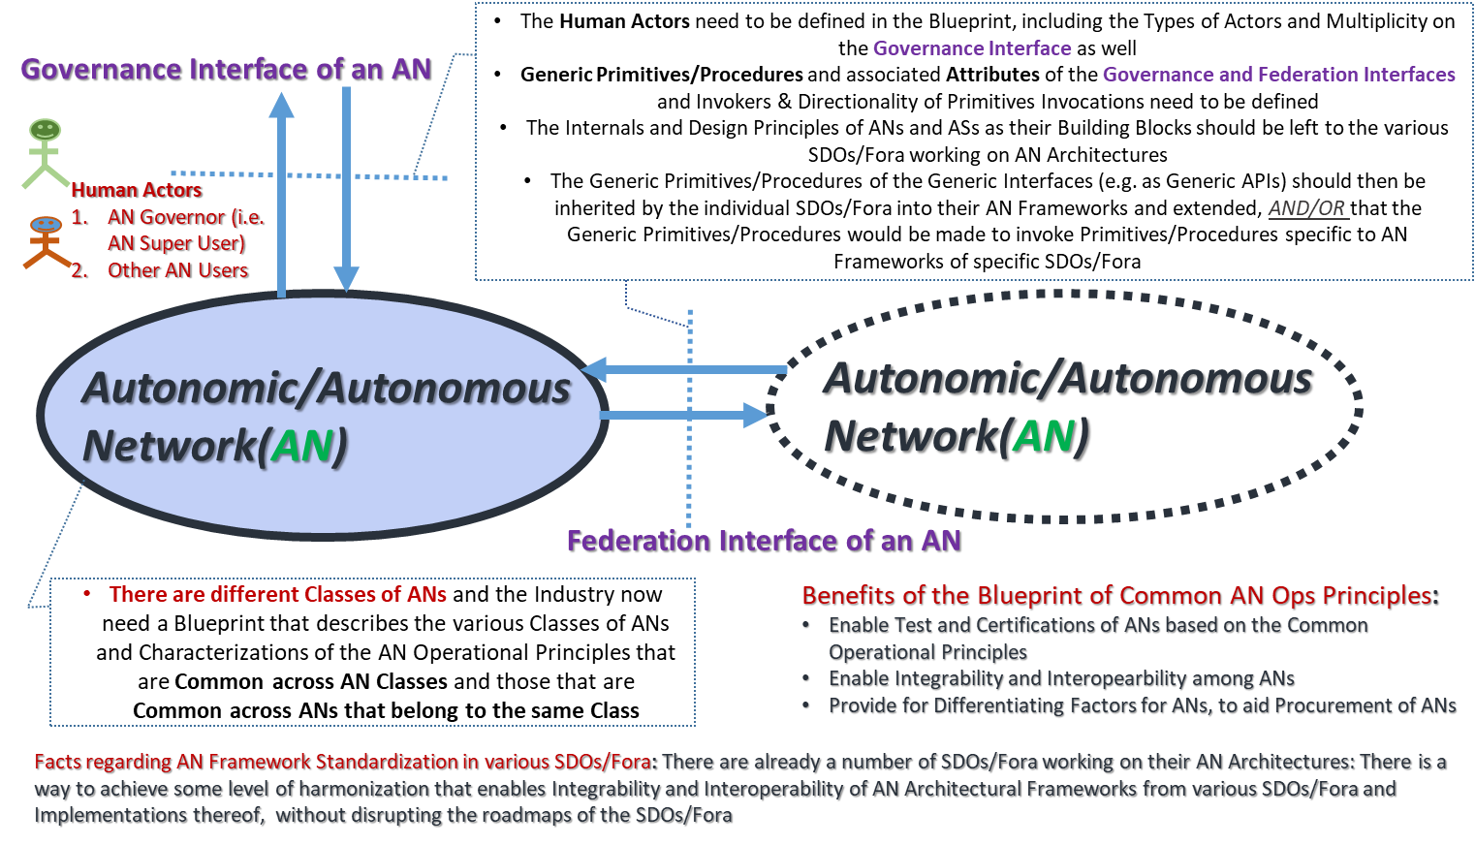
IEEE Proposal: Conceptual Model for Developing the COPAAN Blueprint

Slide 31
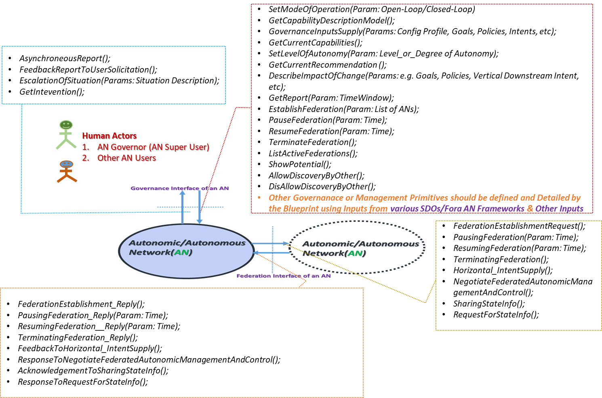
IEEE Proposal: Examples of Primitives of the Conceptual Model of an AN that would need to be specified and detailed in the Blueprint
          Joint SDOs/Fora Industry Harmonization Initiative on Standards & Architectures on Emerging Network Technologies (e.g. 5G, SDN, NFV, AMC)

