Slide 1
Update on HIPAA Audits, Policy, and Enforcement Serena Mosley-Day Office for Civil Rights (OCR) U.S. Department of Health and Human Services October 18, 2018

Slide 2
Updates
Audit
Policy Update
Enforcement Update

Slide 3
Audit Update

Slide 4
Audit Program Purpose & Status
Desk audits of covered entities completed – Sept 2017
Desk audits of business associates completed – Dec 2017
Website updates with summary findings will be published in 2018

Slide 5
Phase 2 - Audit Provisions
For Covered Entities (166):
Security Rule (63): risk analysis and risk management;
Breach Notification Rule: content and timeliness of notifications; or
Privacy Rule: NPP and individual access right
For Business Associates (41):
Security Rule: risk analysis and risk management and
Breach Notification Rule: reporting to covered entity
See auditee protocol guidance for more details: http://www.hhs.gov/sites/default/files/2016HIPAADeskAuditAuditeeGuidance.pdf

Slide 6
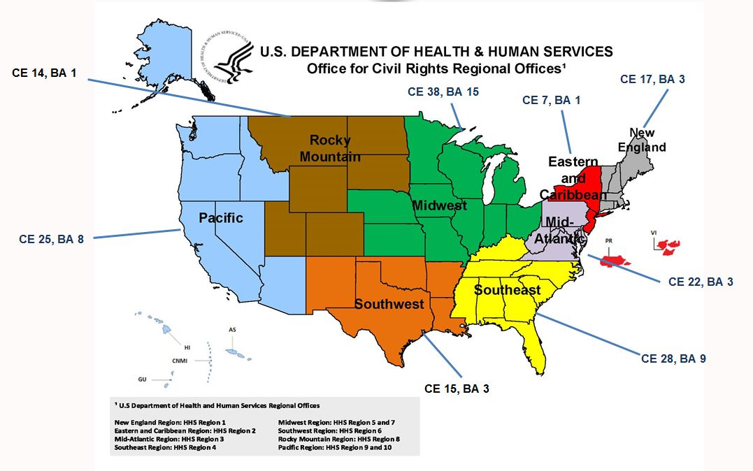
OCR Audits by Region

Slide 7
Initial Audit Take-Aways
Best Outcomes
Providing timely notice of breach
Posting of NPP on website
Providing required NPP content
OCR will examine entity practices for lessons learned that can be shared in technical assistance
Most Room for Improvement
Risk Management
Risk Analysis
Enabling Individual Access
Review OCR guidance and technical assistance

Slide 8
Policy Update

Slide 9
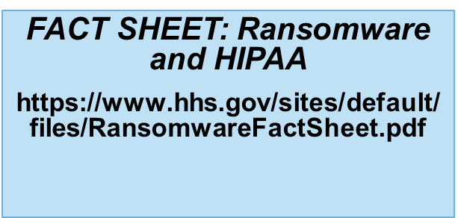
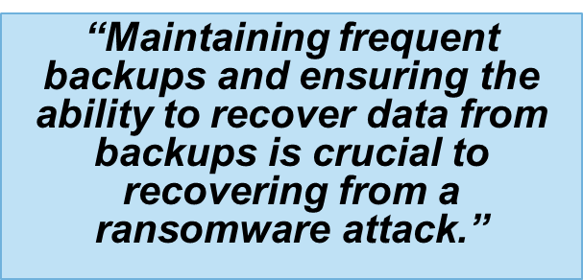
Ransomware
Following the May 2017 WannaCry ransomware attack, HHS reminded organizations to adhere to the OCR ransomware guidance as part of strong cyber hygiene.
OCR presumes a breach in the case of a ransomware attack.

Slide 10
Cyber Security Guidance Materials

Slide 11
Proposed Changes to HIPAA Privacy and Enforcement Rules
Notice of Proposed Rulemaking on Good Faith Disclosures by Health Care Providers to Address Opioid Crisis
Request for Information on Improving Care Coordination and Reducing Regulatory Burden
Notice of Privacy Practices
Required Provider to Provider Information Sharing
Accounting of Disclosures
Request for Information on Distribution of a Percentage of Civil Monetary Penalties or Monetary Settlements to Harmed Individuals
Notes:
Items have been listed on the Department’s regulatory Spring 2018 agenda: https://www.reginfo.gov/public/do/eAgendaMain?operation=OPERATION_GET_AGENCY_RULE_LIST&currentPub=true&agencyCode=&showStage=active&agencyCd=0900.
OCR does not comment on regulatory proposals, and has no additional information that can be shared at this time with respect to timing or other details.

Slide 12
Future HIPAA Guidance
Texting
Social Media
Encryption

Slide 13
Enforcement Update

Slide 14
HHS/OCR Breach Reports
OCR posts breaches affecting 500+ individuals on OCR website (after verification of report)
Public can search and sort posted breaches
OCR opens investigations into breaches affecting 500+ individuals, and into number of smaller breaches
Investigations involve looking at:
Underlying cause of the breach
Actions taken to respond to the breach (including compliance with breach notification requirements) and prevent future incidents
Entity’s compliance prior to breach

Slide 15
Latest Breach Reporting Highlights
September 2009 through April 30, 2018
Approximately 2,285 reports involving a breach of PHI affecting 500 or more individuals
Theft and Loss are 44% of large breaches
Hacking/IT now account for 19% of incidents
Laptops and other portable storage devices account for 25% of large breaches
Paper records are 21% of large breaches
Individuals affected are approximately 262,262,738
Approximately 347,103 reports of breaches of PHI affecting fewer than 500 individuals

Slide 16
HIPAA Breach Highlights
500+ Breaches by Type of Breach
Oct 1, 2015 through Sep 30, 2018
Jan 1, 2018 through Sep 30, 2018

Slide 17
500+ Breaches by Location of Breach
September 23, 2009 through December 31, 2017

Slide 18
July 2017
Revised HIPAA Breach Reporting Tool
The revised web tool still publicly reports all breaches involving 500 or more records – but presents that information in a more understandable way.
The HBRT also features improved navigation for both those looking for information on breaches and ease-of-use for organizations reporting incidents.
The tool helps educate industry on the types of breaches that are occurring, industry-wide or within particular sectors, and how breaches are commonly resolved following investigations launched by OCR, which can help industry improve the security posture of their organizations.

Slide 19
Key Improvements
Indicates active cases under investigation within last 24 months
Help for consumers provides tools on identity theft
Archive tab takes users to OCR’s database of all breach cases
https://ocrportal.hhs.gov/ocr/breach/breach_report.jsf

Slide 20
Advanced Search Functions

Slide 21
General HIPAA Enforcement Highlights
Over 190,661 complaints received to date
Over 26,296 cases resolved with corrective action and/or technical assistance
Expect to receive over 24,000 complaints this year
In most cases, entities able to demonstrate satisfactory compliance through voluntary cooperation and corrective action
In some cases though, nature or scope of indicated noncompliance warrants additional enforcement action
Resolution Agreements/Corrective Action Plans
56 settlement agreements that include detailed corrective action plans and monetary settlement amounts
3 civil money penalties*
*Does not include MD Anderson

Slide 22
HIPAA Resolution Agreements and Civil Monetary Penalties
56 settlements and 3 civil money penalties through October 15, 2018
*Year To Date

Slide 23
HIPAA Enforcement
Settlements Since 2017 OCR NIST Conference ~
Dec. 2017 | 21st Century Oncology | $2,300,000
Feb. 2018 | Fresenius Medical Care North America | $3,500,000
Feb. 2018 | Filefax | $100,000
Aug. 2018 | Boston Medical Center | $100,000
Sep. 2018 | Brigham and Women's Hospital | $384,000
Sep. 2018 | Massachusetts General Hospital | $515,000
Oct. 2018 | Anthem, Inc. | $16,000,000
Total $22,899,000

Slide 24
Recurring Compliance Issues
Business Associate Agreements
Risk Analysis
Failure to Manage Identified Risk, e.g. Encrypt
Lack of Transmission Security
Lack of Appropriate Auditing
No Patching of Software
Insider Threat
Improper Disposal
Insufficient Data Backup and Contingency Planning

Slide 25
Impermissible Disclosure and Safeguards
A covered entity or business associate may not use or disclose protected health information, except as permitted or required by the Privacy Rule. See 45 C.F.R. § 164.502(a).
A covered entity must have in place appropriate administrative, technical, and physical safeguards that protect against uses and disclosures not permitted by the Privacy Rule, as well as that limit incidental uses or disclosures. See 45 CFR 164.530(c).

Slide 26
Case Example: St. Luke’s
Institute operated by CE impermissibly faxed the complainant’s PHI to the complainant’s employer
Institute for Advanced Medicine which provides comprehensive health services to persons living with HIV or AIDS and other chronic diseases
Disclosure included: HIV status, STDs, sexual orientation, and physical abuse
Similar incident 9 months prior; no changes made
$387,000 – May 2017

Slide 27
Case Example: Filefax
OCR determined that Filefax disclosed the PHI of 2,150 individuals between January 28, 2015 and February 14, 2015
Disclosed by leaving the PHI in an unlocked truck in the Filefax parking lot, OR by granting permission to an unauthorized person to remove the PHI from Filefax, and leaving the PHI unsecured outside the Filefax facility
A company was appointed as a receiver to liquidate Filefax’s assets
$100,000 – Feb 2018

Slide 28
Lack of Proper Auditing
The HIPAA Rules require the “[implementation of] hardware, software, and/or procedural mechanisms that record and examine activity in information systems that contain or use electronic protected health information.” See 45 C.F.R. § 164.312(b).
Once audit mechanisms are put into place on appropriate information systems, procedures must be implemented to “regularly review records of information system activity, such as audit logs, access reports, and security incident tracking reports.” See 45 C.F.R. § 164.308(a)(1)(ii)(D).
Notes:
Technical safeguards -Audit controls
Admin safeguards – Information System Activity Review
Dovetail and work together. 3 (also physical)

Slide 29
Case Example: Memorial Healthcare System
The login credentials of a former employee of an affiliated physician’s office had been used to access MHS ePHI on a daily basis without detection from April 2011 to April 2012
Affected 80,000 individuals
Failure to implement procedures to review, modify and/or terminate users’ right of access.
Failure to regularly review records of information system activity on applications that maintain ePHI by workforce users and users at affiliated physician practices, despite having identified this risk on several risk analyses conducted from 2007 to 2012
$5.5 million - February 2017

Slide 30
Risk Management
The Risk Management provision of the Security Rule requires a covered entity to implement security measures sufficient to reduce risks and vulnerabilities to a reasonable and appropriate level. See 45 C.F.R. § 164.308(a)(1)(ii)(B)

Slide 31
Case Example: 21st Century Oncology
On two occasions in 2015, the FBI notified 21CO that PHI was illegally obtained by an unauthorized third party and produced 21CO patient files purchased by an FBI informant
21CO determined that 2,213,597 individuals were affected
Failure to conduct an accurate and thorough assessment of the potential risks and vulnerabilities to the confidentiality, integrity, and availability of the ePHI
Failure to implement security measures sufficient to reduce risks and vulnerabilities to a reasonable and appropriate level
Failure to implement procedures to review information system activity, such as audit logs
Disclosed PHI to 3rd party vendors without BAAs
May 25, 2017, 21CO filed for Chapter 11 bankruptcy protection
$2.3 million - December 2017

Slide 32
Recent Enforcement Activity
ABC Cases $999,000
Boston Medical Center - $100,000
Brigham and Women’s Hospital - $384,000
Massachusetts General Hospital - $515,00
BWH and MGH are members of Partners Healthcare - an integrated health care delivery system that includes community hospitals, primary care and specialty physicians, specialty facilities, community health centers and other health-related entities
All three involved filming for “Save My Life: Boston Trauma”
Similar to another ABC TV show – “NY Med”
“NY Med” resulted in a 2016 settlement with NY Presbyterian for $2.2m
OCR Filming Guidance - https://www.hhs.gov/hipaa/for-professionals/faq/2023/film-and-media/index.html

Slide 33
Recent Enforcement Activities
Anthem, Inc. - $16,000,000
78.8m individuals affected
Largest health data breach in U.S.
Gained access through spear fishing in Feb. 2014
Data extracted from Dec. 2014 to Jan. 2015
Included names, addresses, dates of birth, email addresses, SSNs, medical ID numbers and employment information
Issues with risk analysis, information system activity review, security incident response and reporting, and access controls
2 other settlements –
National Association of Insurance Commissioners (Dec. 2016)
Class Action (Aug. 2018)

Slide 34
Corrective Actions May Include:
Updating risk analysis and risk management plans
Updating policies and procedures
Training of workforce
Implementing specific technical or other safeguards
Mitigation
CAPs may include monitoring

Slide 35
Best Practices to Consider:
Review all vendor and contractor relationships to ensure BAAs are in place as appropriate and address breach/security incident obligations
Risk analysis and risk management should be integrated into business processes; conducted regularly and when new technologies and business operations are planned
Dispose of PHI on media and paper that has been identified for disposal in a timely manner
Incorporate lessons learned from incidents into the overall security management process
Provide training specific to organization and job responsibilities and on regular basis; reinforce workforce members’ critical role in protecting privacy and security

Slide 36
Cybersecurity Resources
Newsletters http://www.hhs.gov/hipaa/for-professionals/security/guidance/index.html
Health Information Technology Portal http://hipaaQsportal.hhs.gov
Medscape http://www.medscape.org/viewarticle/876110

Slide 37
For More Information
http://www.hhs.gov/hipaa
Join our Privacy and Security listservs at https://www.hhs.gov/hipaa/for-professionals/list-serve/
Find us on Twitter @hhsocr

