Slide 1
NIST Healthcare Testing Infrastructure Overview Interoperability by way of Standards, Conformance, and Testing Tools
June 2021
Robert Snelick, NIST
Introduction
Part 1 of 3

Slide 2
Video Series
Part 1
NIST HL7 v2 Testing Infrastructure Overview
Part 2
NIST Conformance Testing Tools
Focus on Immunization Test Suite
Part 3
NIST Development and Testing Platform
Supplement
Background: HL7 v2, Conformance, Interoperability

Slide 3
Overview
What are we Doing
Improving Healthcare Data Exchange Interoperability
Improve Healthcare Data Quality
Who are the Users
Healthcare Information Technology Vendors
Public Health (CDC, APHL, AIRA, etc.)
Certification and Testing Organization
Standards Development Organization
Impact
Improved Quality of Care (better data/better care)
Cost

Slide 4
End-to-End Approach
Constructs for specifying requirements
Tools for creating computable specifications
Tools for creating Testing Cases
Platform for creating Conformance Test Tools
Framework for testing Implementations
Gives the power to the users
Make it simpler, like Tax Software
Notes:
Make analogy that no one like to do taxes, in software implementation no one likes to do precise requirement specification, conformance, and testing. It is PAINFUL.

Slide 5
Acronyms – For Reference
HL7 – Health Level 7 (Standards Dev. Org)
CDC – Centers for Disease Control and Prevention
AIRA – American Immunization Registry Association
IIS – Immunization Information System
APHL – Association of Public Health Laboratory
IHE – Integrating the Healthcare Enterprises
ONC – Office of the National Coordinator (HHS)
MU – Meaningful Use (CMS EHR Certification)
IGAMT – Implementation Guide Authoring and Management Tool (NIST Tool)
TCAMT – Test Case Authoring and Management Tool (NIST Tool)
GVT – General Validation Tool

Slide 6
Heart of what NIST Does
Conformance Testing
Does the system implement the requirements as stated in the specification?
But relies on:
Requirements
Computable Formats
Test Cases
Test Data
Specification
Conformance
Implementation

Slide 7
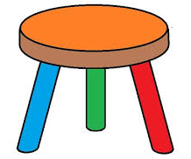
Foundation for Interoperability
Well-defined Standards
Testing
Implementation
Standards Development Lifecycle
Standards
Testing
Implementation
HIT Interoperability
Implementation
Well-defined Standards
Conformance Testing
Notes:
“well-defined standards” → having and using conformance constructs correctly.
Single method to specify a requirements
Computable
Requirements specific for use case
Codes that are only relevant for use case
MORE…..
Standards must be created and adopted
Not just standards, but well-defined standards (they must be understandable)
Standards must be specific (profiled for use)
Standards should/must be represented in a computable format
Send good acknowledgements
Implementations must be tested for conformance
Systems must be tested for interoperability

Slide 8
Failure happens when:
One or more components are omitted or are not sufficient
Standards
Testing
Implementation
HIT
ability
Inter
oper
Implementation
Well-defined Standards
X
Conformance Testing

Slide 9
HL7 and HL7 v2
Health Level 7—SDO
HL7 v2
Healthcare Data Exchange Messaging Standard
Most widely used healthcare standard
E.g., Most lab reporting and immunization records
Nearly all Public Health systems use HL7 v2
Reportable Result
3a
Order
Laboratory System
EHR
3b
Public Health
1
2
LIS
Result
Reportable Result

Slide 10
Example HL7 v2 COVID-19 Message
MSH|^~\&|COVID-19NISTAPP|COVID-19NISTFAC|COVID-19IISAPP|COVID-19IISFAC|20201228084727.655-0500||VXU^V04…
PID|1||89778^^^NIST-MPI-1^FI||Wong^Elise^^^^^L|Xhang^^^^^^M|19880417|F||2028-9^Asian^CDCREC~2131-1^Other Race^CDCREC|89 West 21st Ave^^Birmingham^AL^35203^USA^P||^PRN^PH^^^406^5554019~^NET^^Elise.Wong@isp.com|||||||||2186-5^Not Hispanic or Latino^CDCREC||N|1|||||N
ORC|RE|5237^NIST-AA-IZ-1|31309^NIST-AA-IZ-1|||||||7824^Jackson^Lily^Suzanne^^^^^NIST-PI-1^L^^^PRN||654^Thomas^Wilma^Elizabeth^^^^^NIST-PI-1^L^^^RPH|||||NISTEHRFAC^NISTEHRFacility^HL70362
RXA|0|1|20201228||80777-0273-99^Moderna COVID-19 Vaccine^NDC^207^COVID-19, mRNA, LNP-S, PF, 100 mcg/ 0.5 mL dose^CVX|0.5|mL^mL^UCUM||00^New Record^NIP001|7824^Jackson^Lily^Suzanne^^^^^NIST-PI-1^L^^^RPH|^^^NIST-Clinic-1||||025L20A|20210205|MOD^Moderna US, Inc.^MVX|||CP|A
RXR|C28161^Intramuscular^NCIT|RD^Right Deltoid^HL70163
OBX|1|CE|30963-3^Vaccine Funding Source^LN|1|VXC50^Public^CDCPHINVS||||||F|||20201228
OBX|2|CE|64994-7^Vaccine Funding Program Eligibility^LN|2|V01^Not VFC Eligible^HL70064||||||F|||20201228|||VXC40^per immunization^CDCPHINVS
OBX|3|CE|69764-9^Document Type^LN|3|253088698300034911201201^COVID-19 Moderna Vaccine EUA Recipient-Caregiver Fact Sheet^cdcgs1vis||||||F|||20201201
OBX|4|DT|29769-7^Date Vis Presented^LN|3|20201228||||||F|||20201228
OBX|5|ST|30973-2^dose number in series^LN|4|1||||||F|||20201228
OBX|6|CE|59783-1^Status in immunization series^LN|4|N^No^HL70136||||||F|||20201228
Wong^Elise^^^^^L
Patient Data
80777-0273-99^Moderna COVID-19 Vaccine^NDC
Vaccine Data
30973-2^dose number in series^LN|4|1
Observations

Slide 11
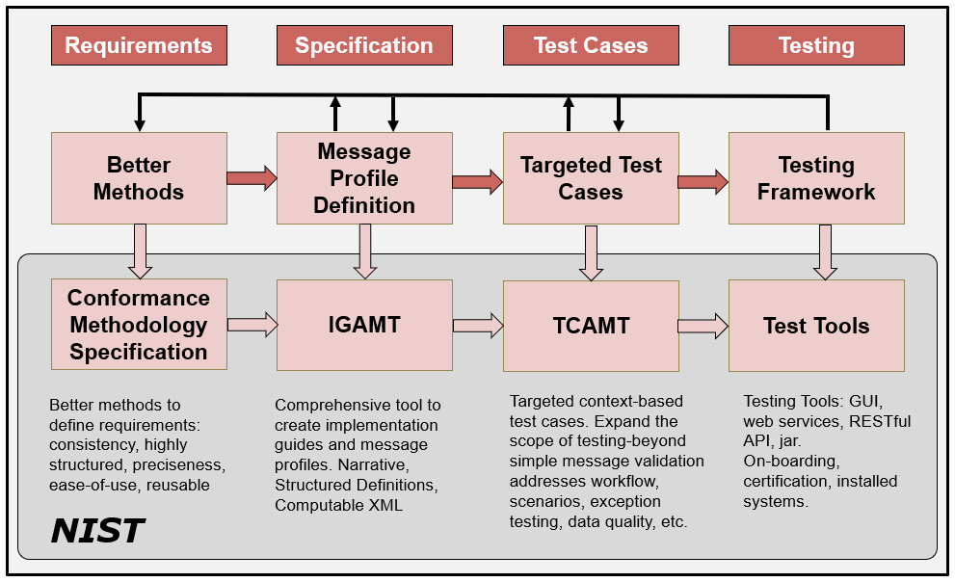
HL7 v2 Development Phases/Cycle
5/28/2021
Notes:
Profiling: Refinements of the standard via constraints and extension.
NOTE: Can implement to the same profiled standard (which is often the goal when the same expectations are the same for sender and receiver).
NOTE 2: A derived specification is a profile, but documentation of an interface is also considered a “derived specification”.

Slide 12
NIST HL7 v2 Tooling Platform
1
Conformance
Methods
Provide the constructs to defined requirements
Tools Generated Automatically
6
Specification Builder
(IGAMT)
XML
Validation Tools
2
3
SMEs
XML
Test Case Builder
(TCAMT)
XML+
5
3
Export
4
Build Targeted Test Cases
Web Applications
Web Services
RESTful APIs
Validation Jar
Source Code
HTML
WORD
PDF
XML
= Machine-Computable

Slide 13
Testing Workflow (Sender)
COVID-19 Vaccine Reporting (Simplified)
1
Select Test Case
2
Tool Provides Test Story and Test Data Sheet
3
Test Data Entered into the EHR System
NIST Test Tool(Acting as an IIS)
Validation Report
EHRs
4
EHR Creates Message and Submits to NIST Validation Tool
5
Tool Provides Validation Report

Slide 14
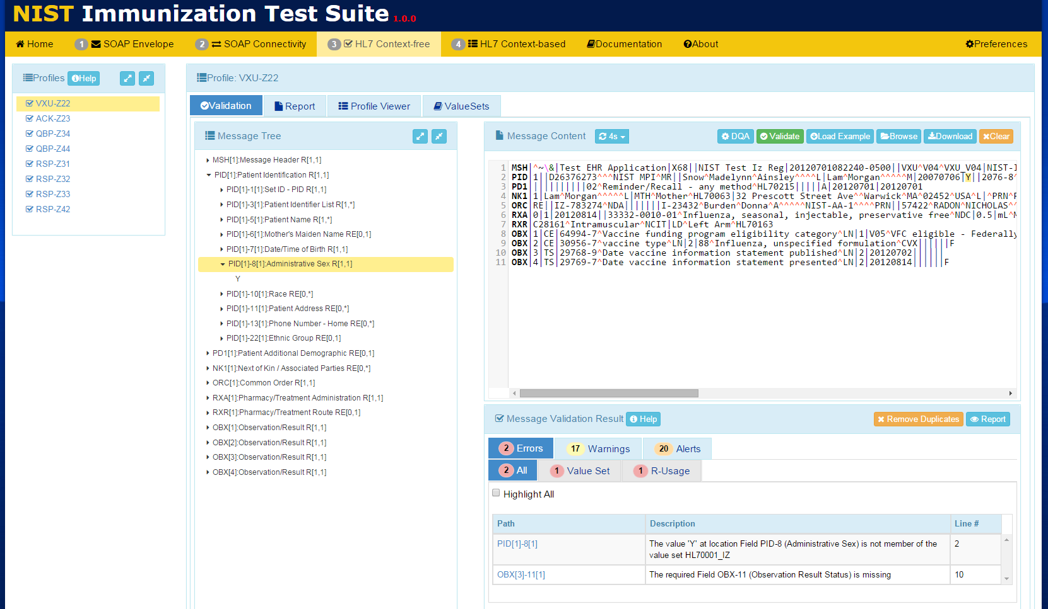
Conformance Testing

Slide 15
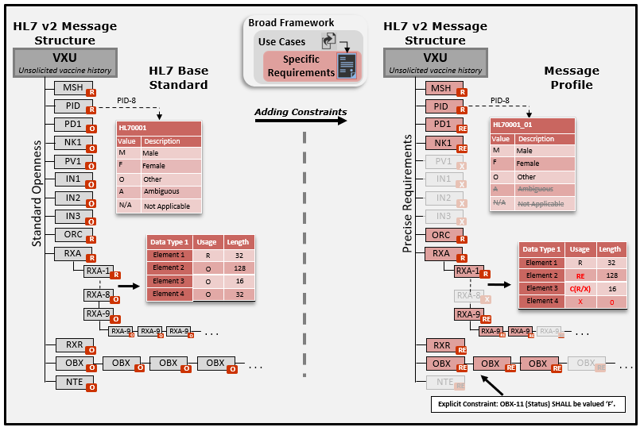
Creating Specifications
Notes:
Applicable to any standard product family.

Slide 16
Creating Specifications
Base Standard (Framework)
}
+
Profiling
Use Case (Requirements)
Use Case Specific Specification
+
Constraints
Notes:
Applicable to any standard product family.

Slide 17
Creating Specifications
IGAMT: Implementation Guide Authoring and Management Tool
Base on Strong Conformance Model
Embedded Data Model
Consistent Specifications
Computable Specifications
Component Reuse
Extensive Publication Capabilities
Easy to Use Web Based Application
Allows Domain Experts to create Conformance Testing Tools
Reduces Maintenance Nightmare
Notes:
Applicable to any standard product family.

Slide 18
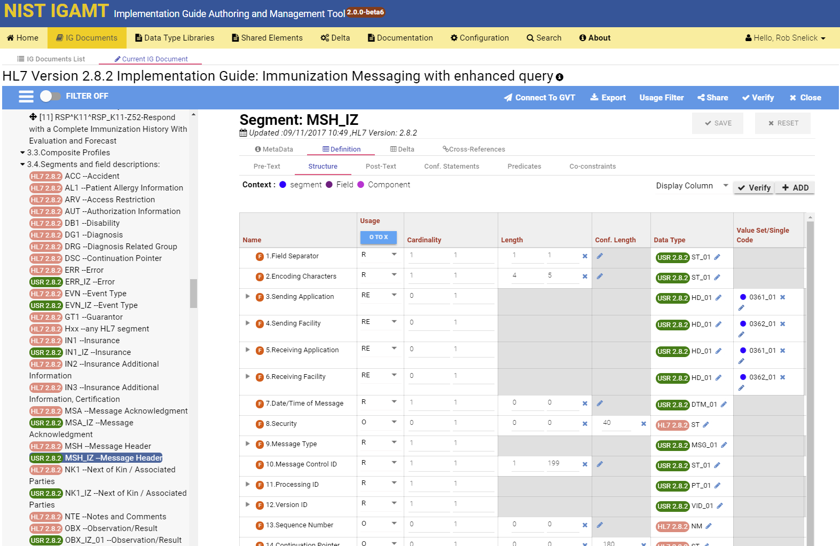
Creating a Specification in IGAMT

Slide 19
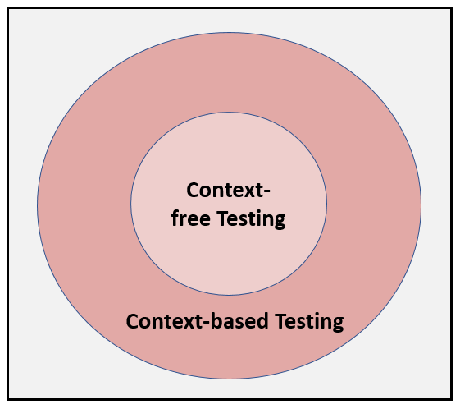
Context-free & based Testing
Context-based has expanded test scope
Scenarios
Targeted Test Cases
Data Driven
Black-box functional requirements testing

Slide 20
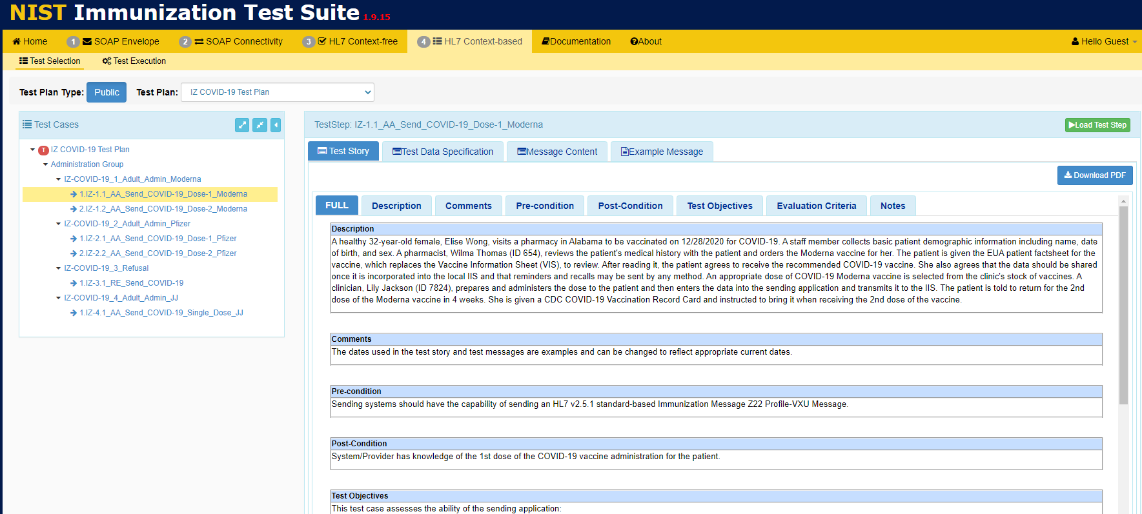
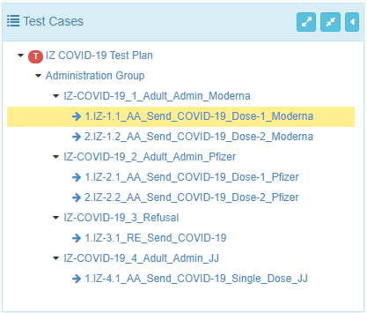
Test Case and Data Driven Testing

Slide 21
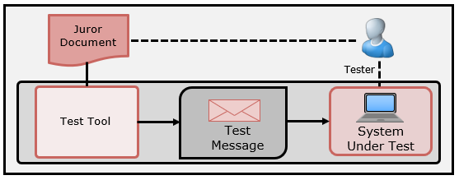
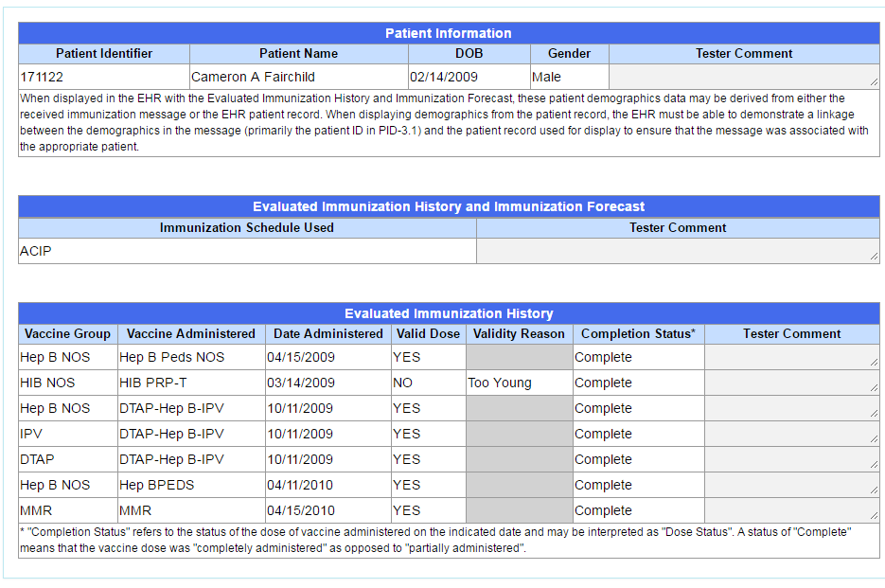
Inspection Testing
Receiver-oriented Testing
Use of an inspection (Juror) Document
Can be used for Incorporation and Display Testing
Test Tool provides the stimulus
Can have levels of storage requirements

Slide 22
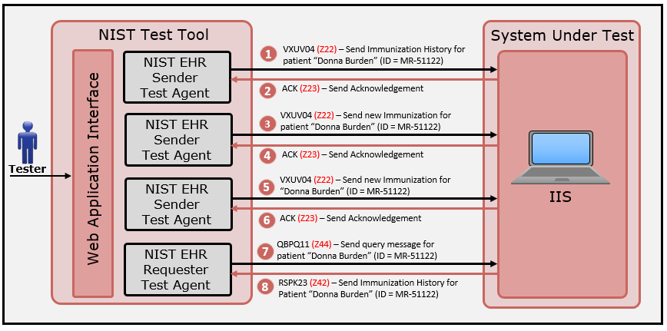
Testing Functional Requirements
Create scenarios to invoke a capability of the SUT
Use context-based testing to validate expected content in the response message

Slide 23
Key Stakeholders and Uses
Healthcare Industry Vendors
HL7 → Uses NIST tools to ballot specifications
IHE → Key part of connect-a-thon Testing
CDC → Used widely (e.g., IZ Gateway)
Public Health → Many Domains
HIMSS → Immunization EHR Certification
AIRA → Immunization Registry Assessment
APHL → Onboarding Lab Systems & COVID
ONC → EHR Certification (Meaningful Use)

Slide 24
Public Health Domains
Results from a laboratory tests, e.g., Cholesterol, Complete Blood Count, HIV, and now COVID-19
Vital Records
Immunizations
Notifiable Diseases
Laboratory Results
Syndromic Surveillance
A disease diagnosis, treatment, and outcome
Birth and Death Certificates
History of vaccinations, forecasts, queries
Symptoms reported in EDs, e.g., High Fever, Shortness of breath, Cough; other → Travel History
All will be handling COVID-19 Data.

Slide 25
Summary
Integrated End-to-end Platform
We have changed the paradigm
We don’t build conformance test tools; we build the tools that builds them
Empowered Domain Experts and SDOs
Improving Healthcare Data Interoperability
Improving Healthcare Data Quality
Improving Quality of Care
Lowering Cost

Slide 26
Thank You
Contact: robert.snelick@nist.gov
https://hl7v2tools.nist.gov

