Slide 1
Structural Materials Data Demonstration Project:
Overview and Update
2015 NIST Diffusion/CALPHAD
Data Informatics and Tools Workshop
May 14-15, 2015
Larry Berardinis, CMD Network, ASM International

Slide 2
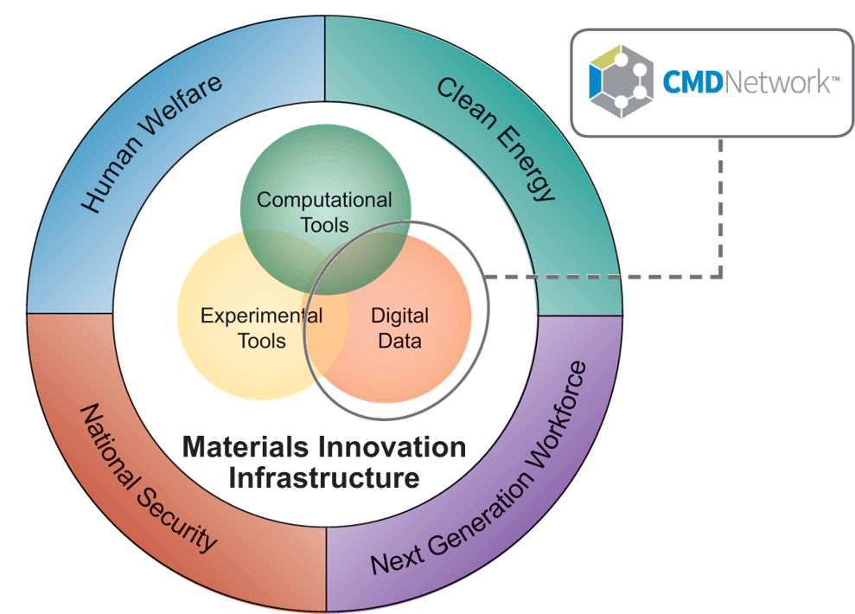
A bit about us
CMD Network was launched in 2012 to assist the scientific and engineering community with its computational materials data needs.
Source: Office of Science and Technology Policy

Slide 3






CMD Network projects

Slide 4
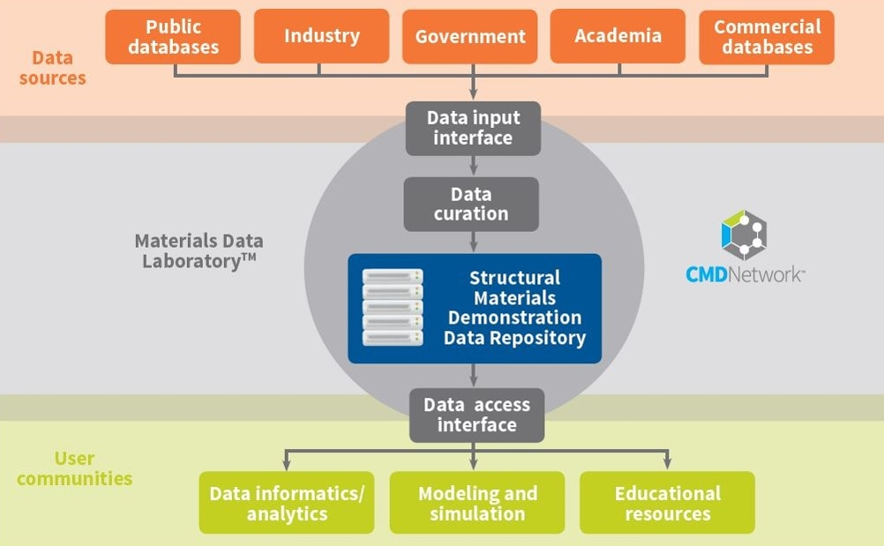

SMDDP in context

Slide 5
SMDDP project objectives
Establish well-pedigreed and curated demonstration datasets for non-proprietary metallic structural materials over all length scales.
Work with NIST and the materials data community to develop materials data schema and ontologies.
Develop and implement data capture and curation procedures that can serve as models for other data repositories.
Develop and carry out a series of test problems that represent relevant use cases for the repository.
Make data open to the materials data community for use in data analytics, modeling, and educational purposes.
Actively engage the materials data community and widely disseminate the findings from the project.

Slide 6


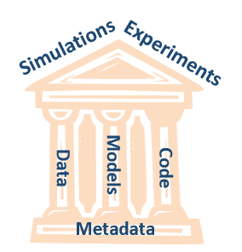




Learn by doing
SMDDP Repository
Source: Jim Warren, NIST

Slide 7
Project roles
ASM International
CMD Network
NIST
Kent State University
Center for Materials Informatics
Granta Design/MDMi
Georgia Tech
Hosting and curation
Project management and outreach (Nexight support)
Data acquisition for “upstream” data
Schema and ontology development
Test and evaluation support
Open access repository development and support
Database structure and development guidance
Import and export interface development
Aluminum 6061 sample processing
Microstructure and mechanical data measurements

Slide 8
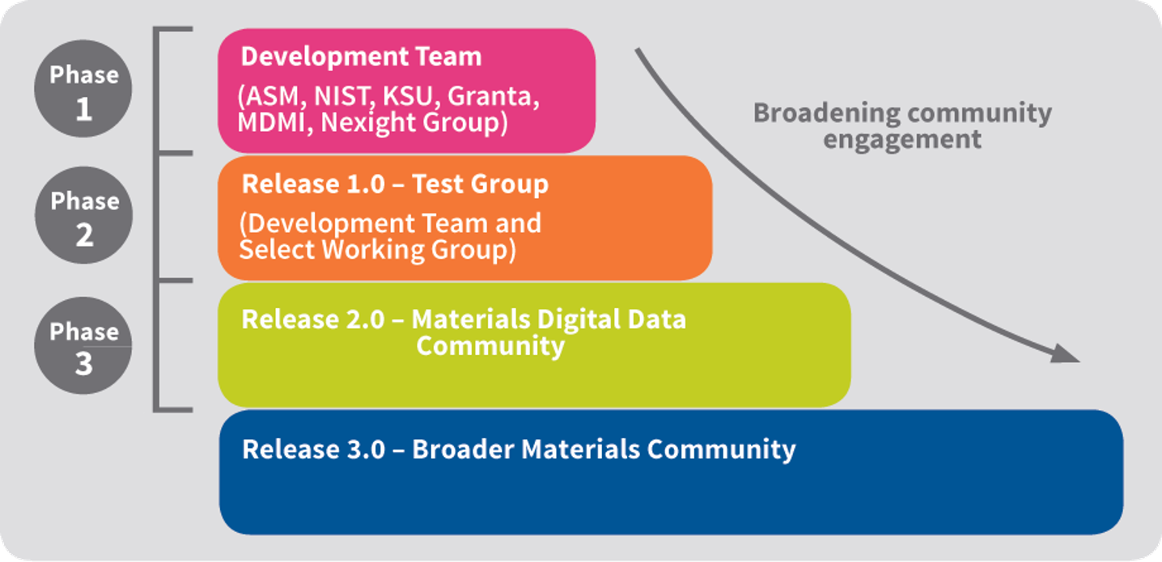
Phased rollout

Slide 9
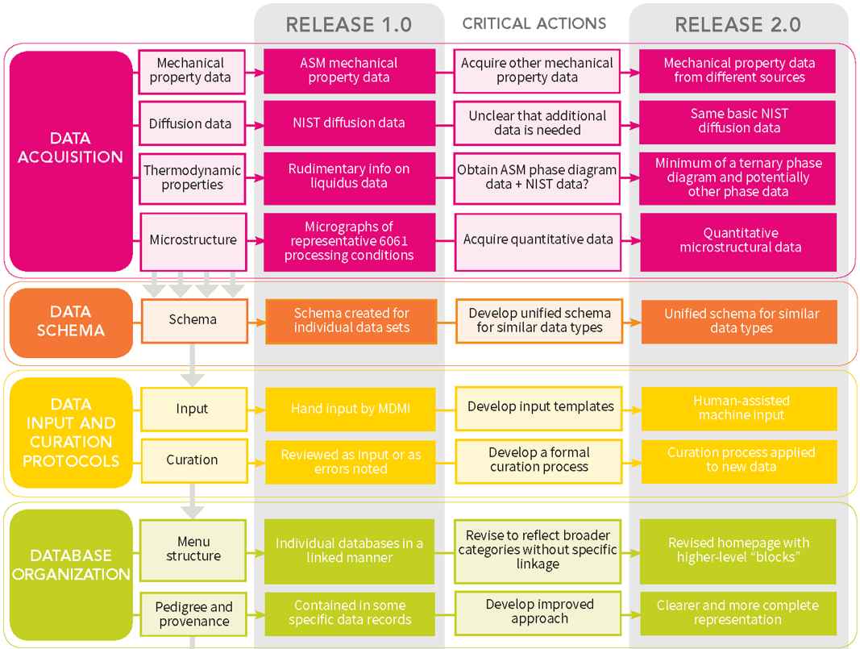
Critical pathways

Slide 10
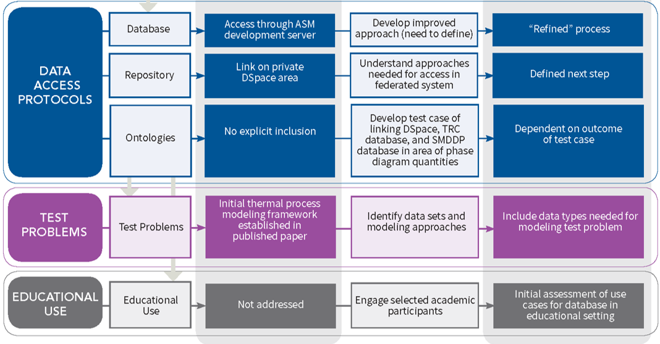
Critical pathways

Slide 11
Where we are now

Slide 12
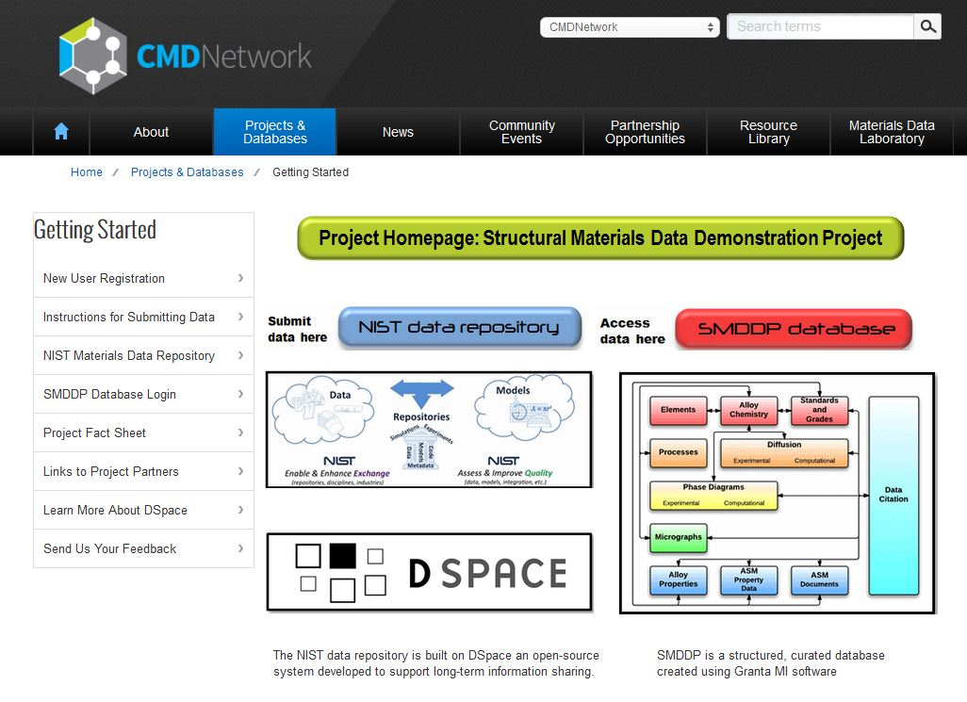
SMDDP project homepage

Slide 13
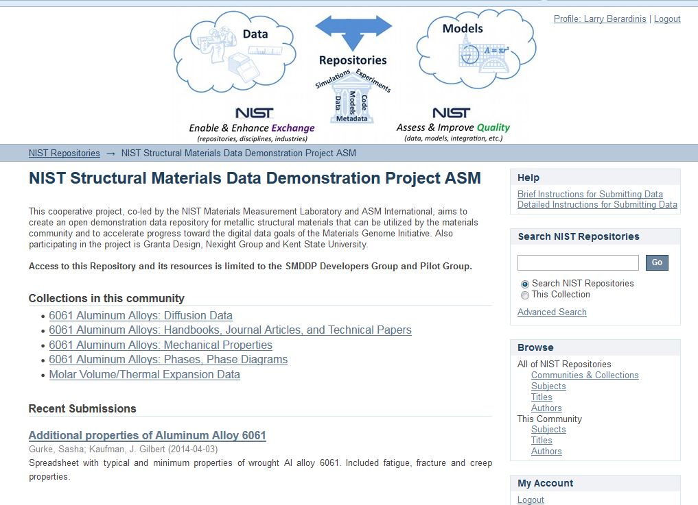
NIST DSpace Repository

Slide 14
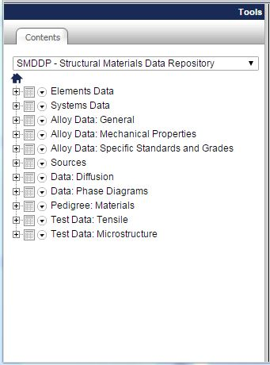
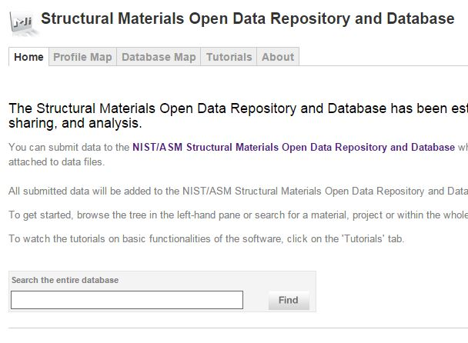
NIST SMDDP Database

Slide 15
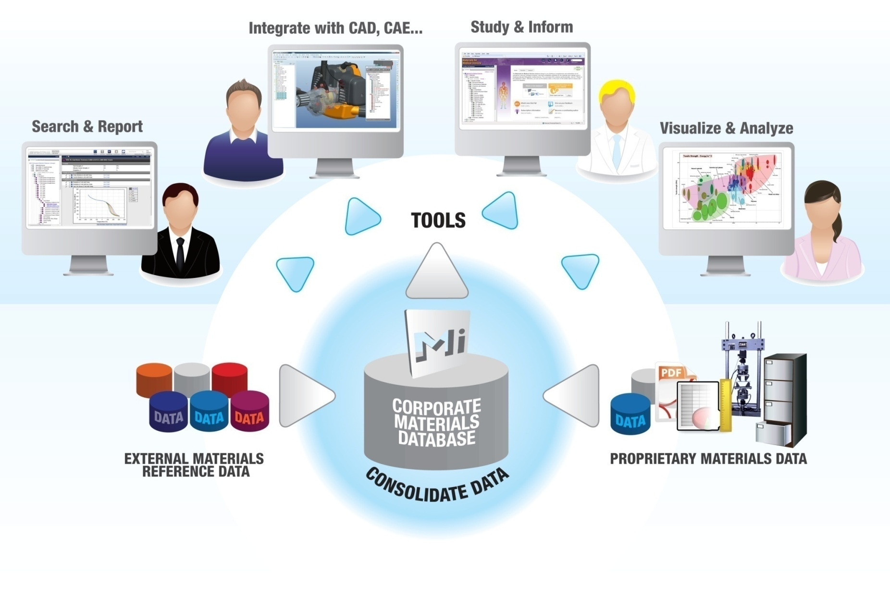
Database functions

Slide 16
Quick database tour

Slide 17
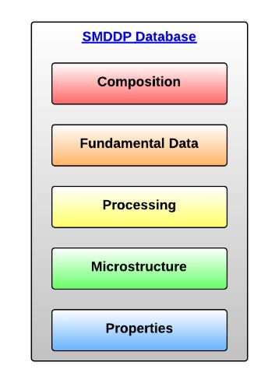
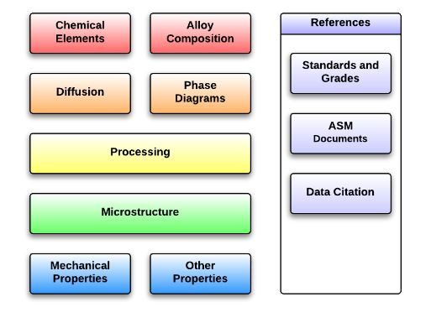
Database and profile maps

Slide 18
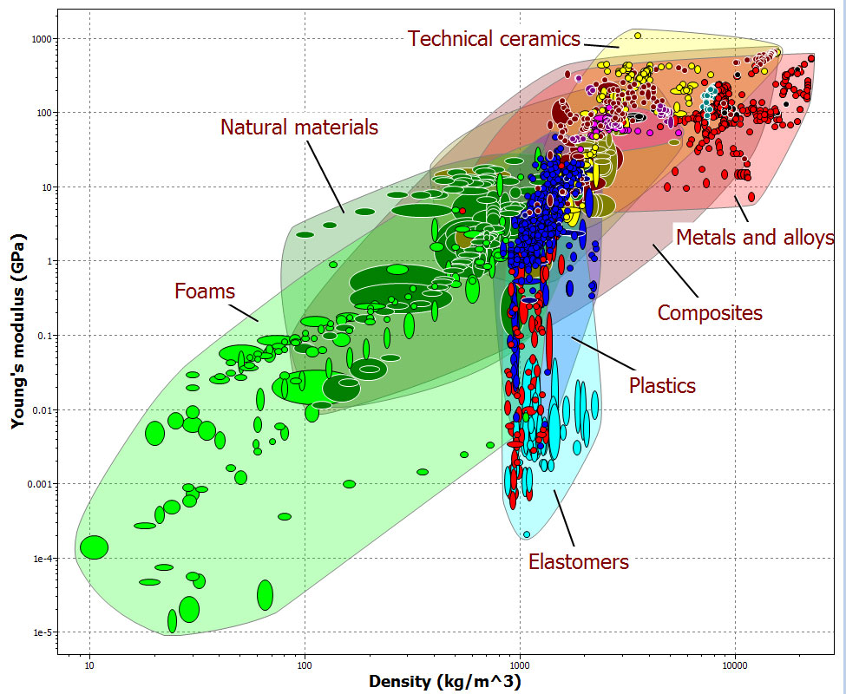
Internet of Things

Slide 19
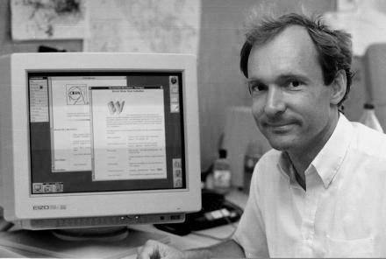

People, things, and data
Tim
“We're entering a new world in which data may be more important than software.”
Berners-Lee
“Data is a precious thing and will last longer than the systems themselves.”
O’Reilly

Slide 20
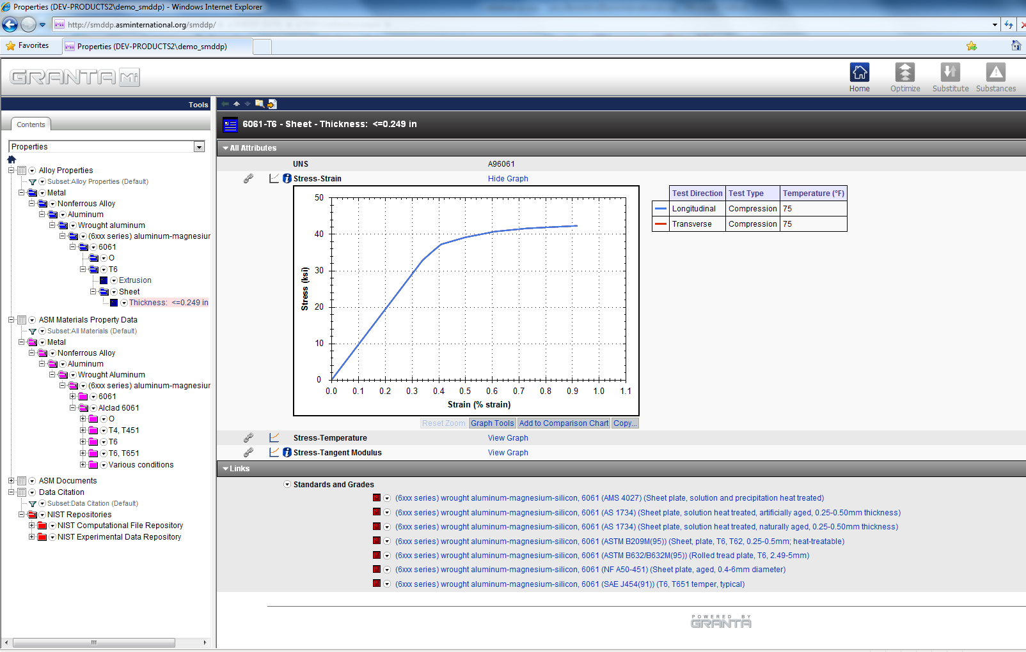
Mechanical property data

Slide 21
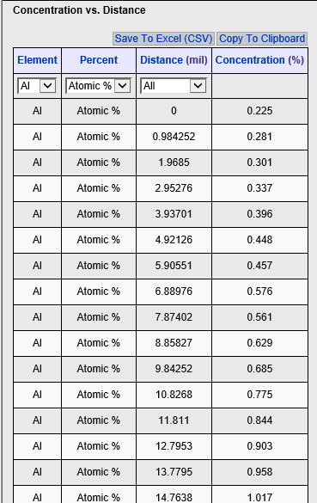
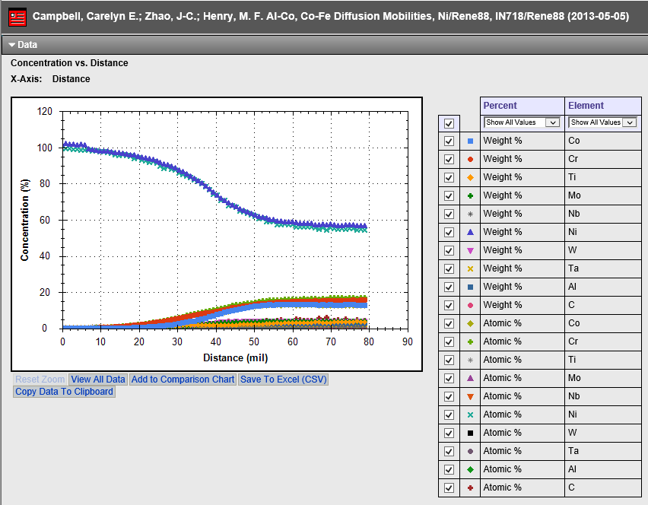
Diffusion data

Slide 22
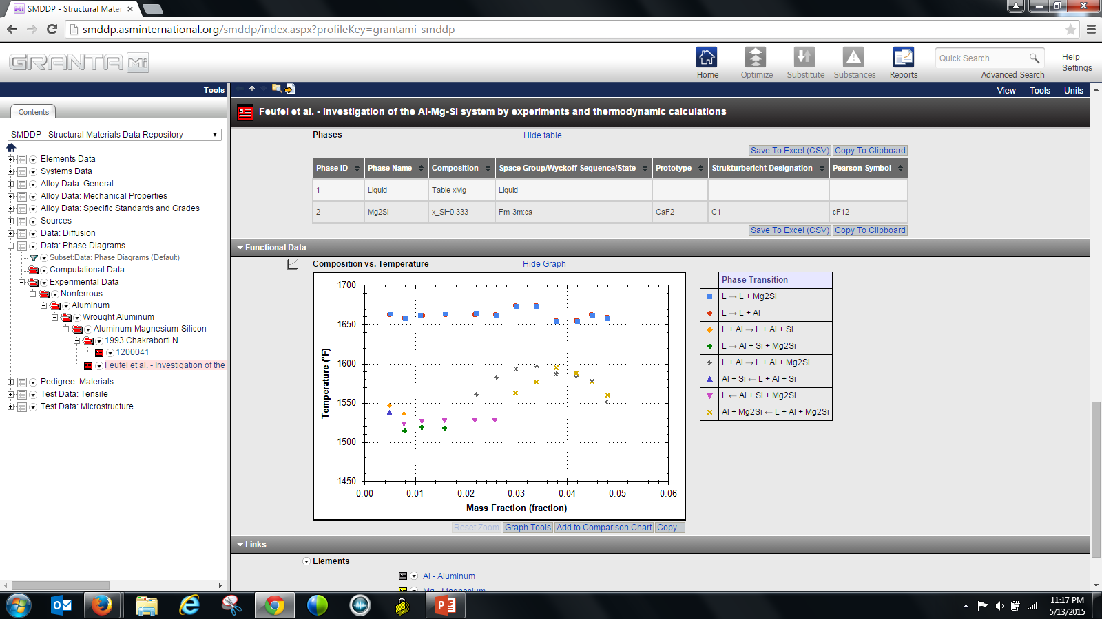
Phase data

Slide 23
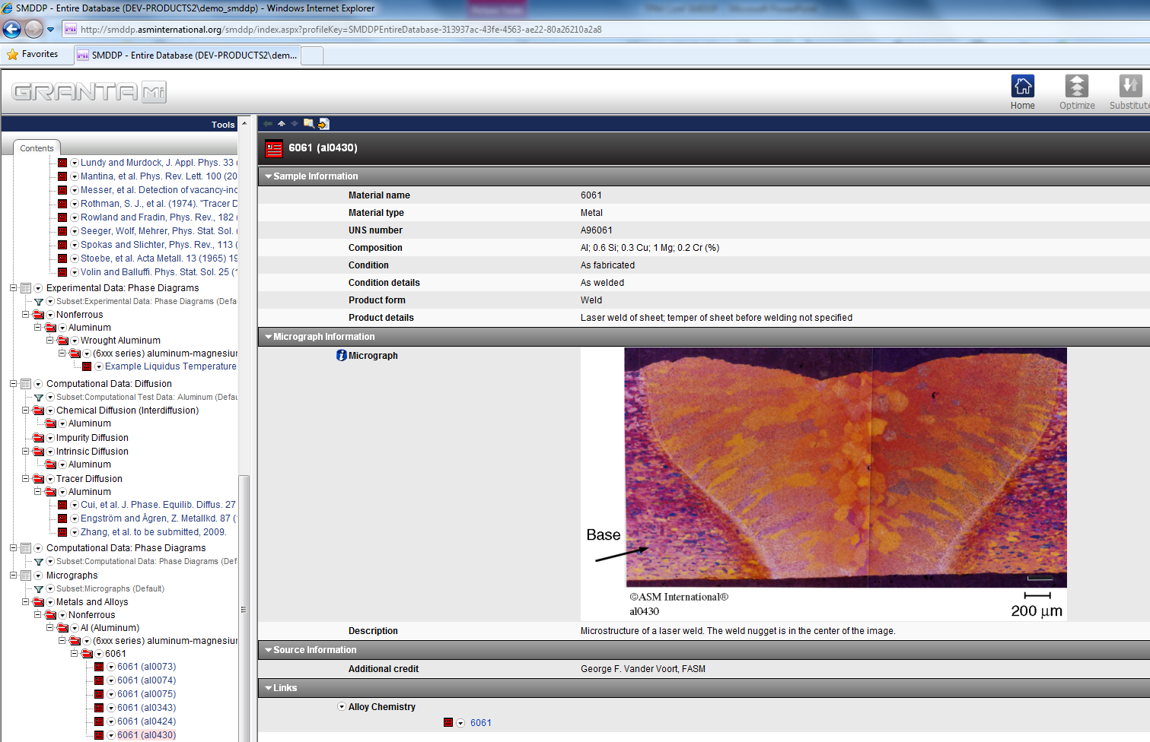
Microstructure data

Slide 24
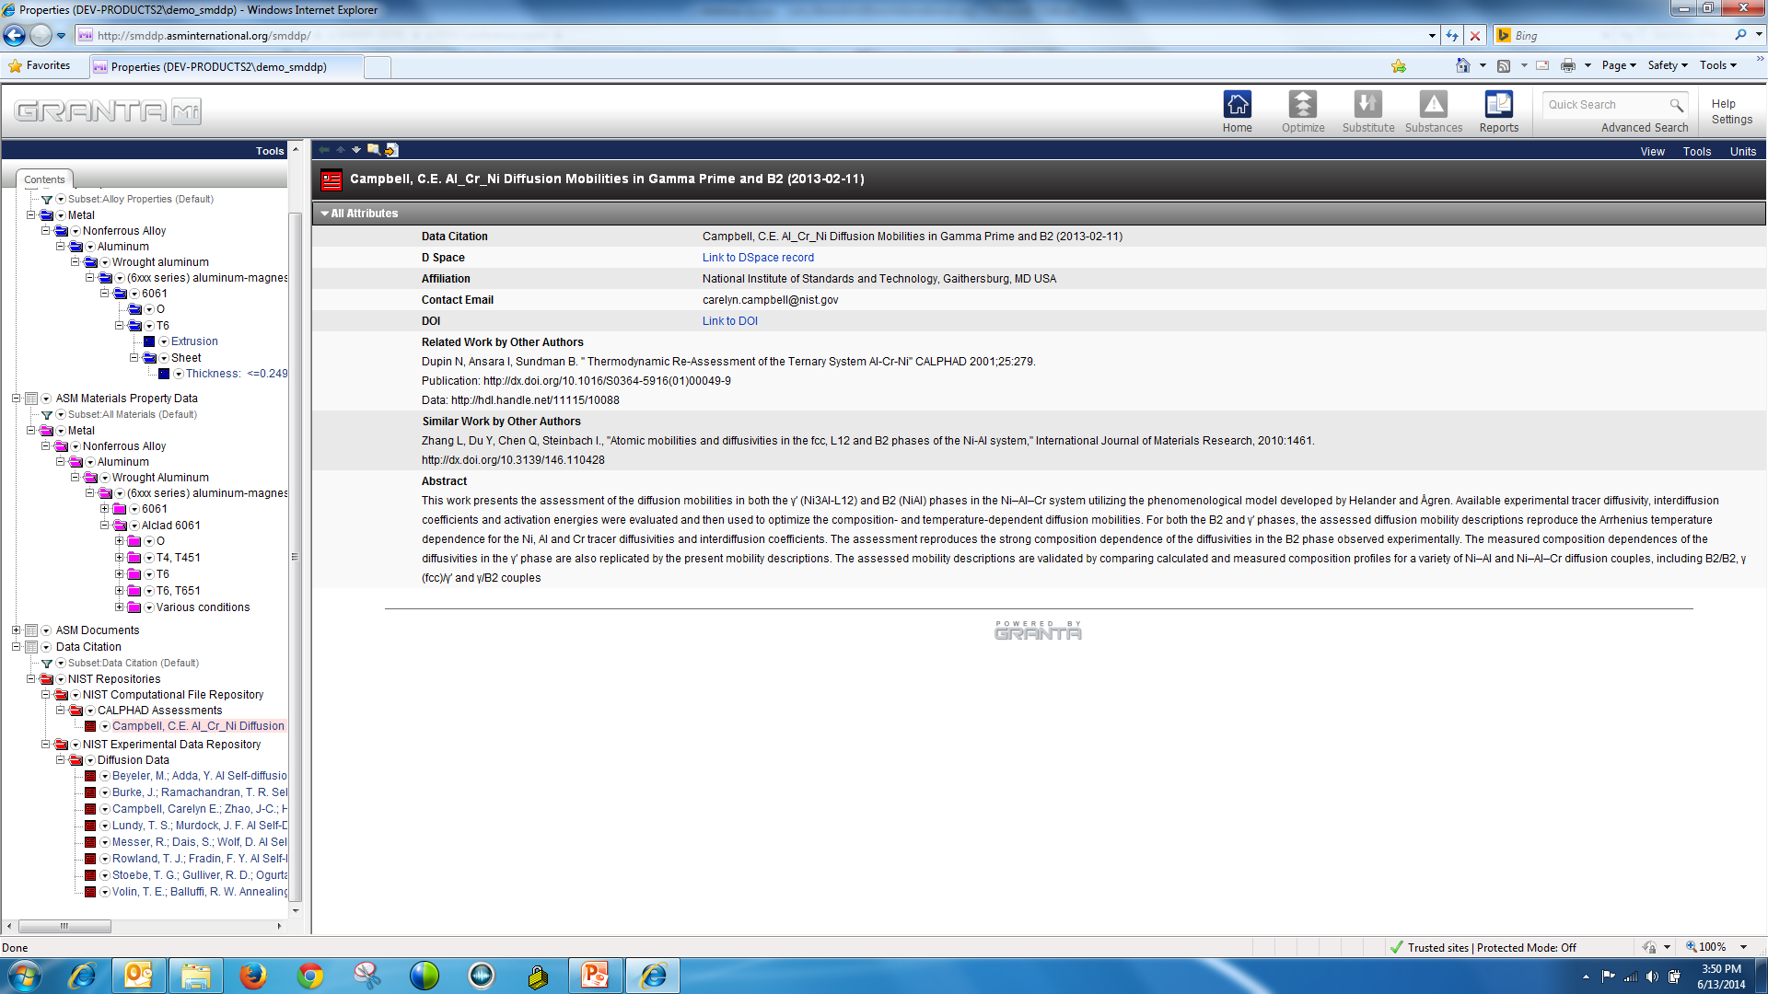
Data citation

Slide 25
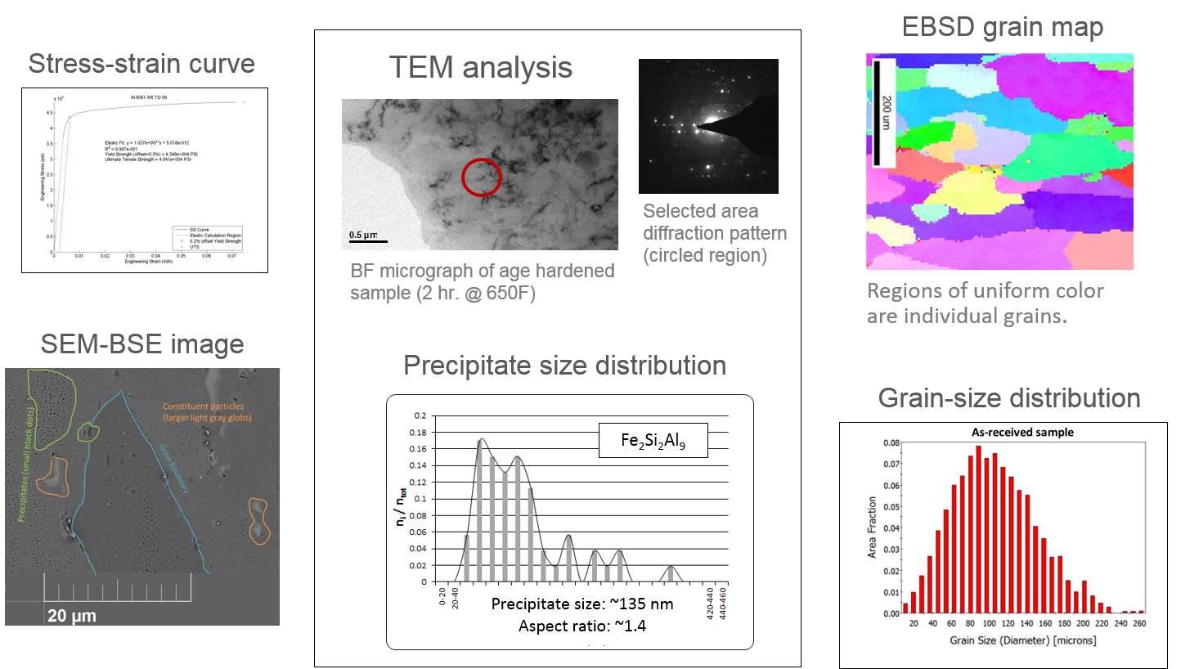
Recently acquired data
Source: Surya Kalidindi, GaTech; Yaakov Idell, NIST

Slide 26
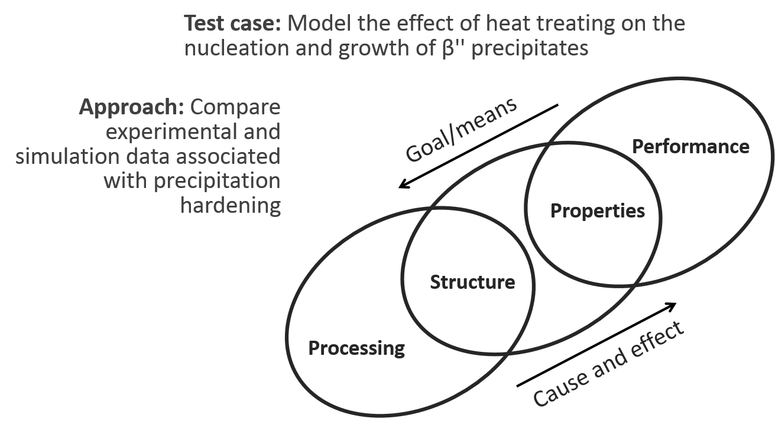
Initial test problem
Source: Greg Olson, Northwestern University

Slide 27
Currently in development
Update schema for diffusion, phase, and microstructure data
Refine pedigree information and curation process
Implement use cases for analytics and modeling
Make preparations for future work in vocabulary development and ontological search techniques

Slide 28
In summary
Created a database for Al 6061 data – mechanical, diffusion, phase, and microstructure data
Created and continuing to refine data schema, metadata, citation, and licensing protocols
Developed and continuing to refine data importers and exporters
Recently added more phase data, additional mechanical property data, and quantitative microstructural data
Preparing to run a series of precipitation simulations and begin modeling the effect of heating on tensile strength
Looking for partners and collaborators
Looking for a Director for the Computational Materials Data Network

Slide 29
Questions?
Thank You

Slide 30
CMDN Workshop Strategy

Slide 31
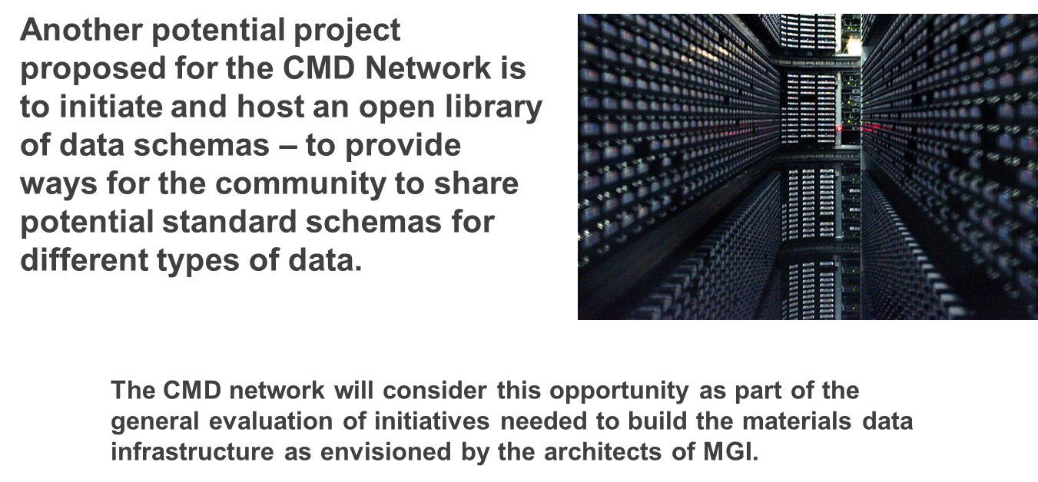
Schema library

Slide 32
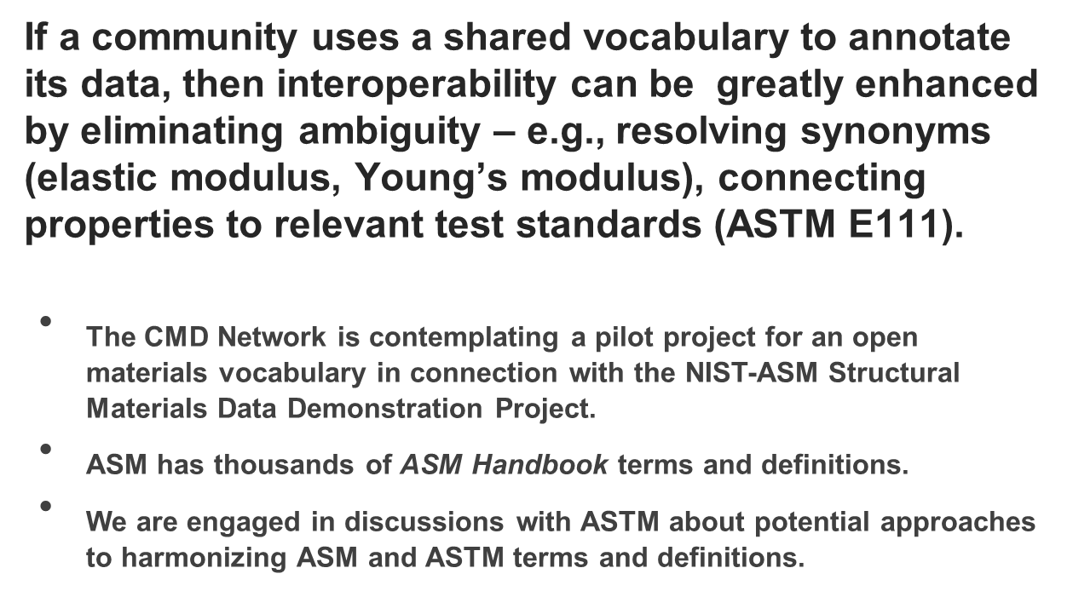
Common materials vocabulary

Slide 33
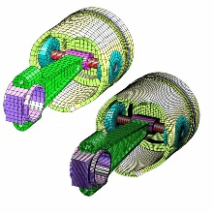
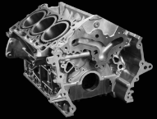

Mainstream design
Material specs
Experiment
Materials outside the computation loop
Simulation

Slide 34

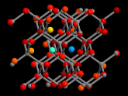
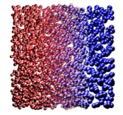
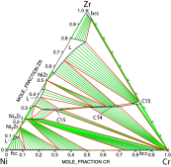
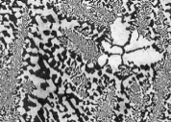
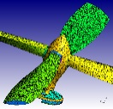
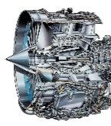

Atoms to airplanes
Materials Genome Initiative
Experiment
Quantum
Nano
Micro
Macro
Simulation
Integrated computational materials engineering

Slide 35
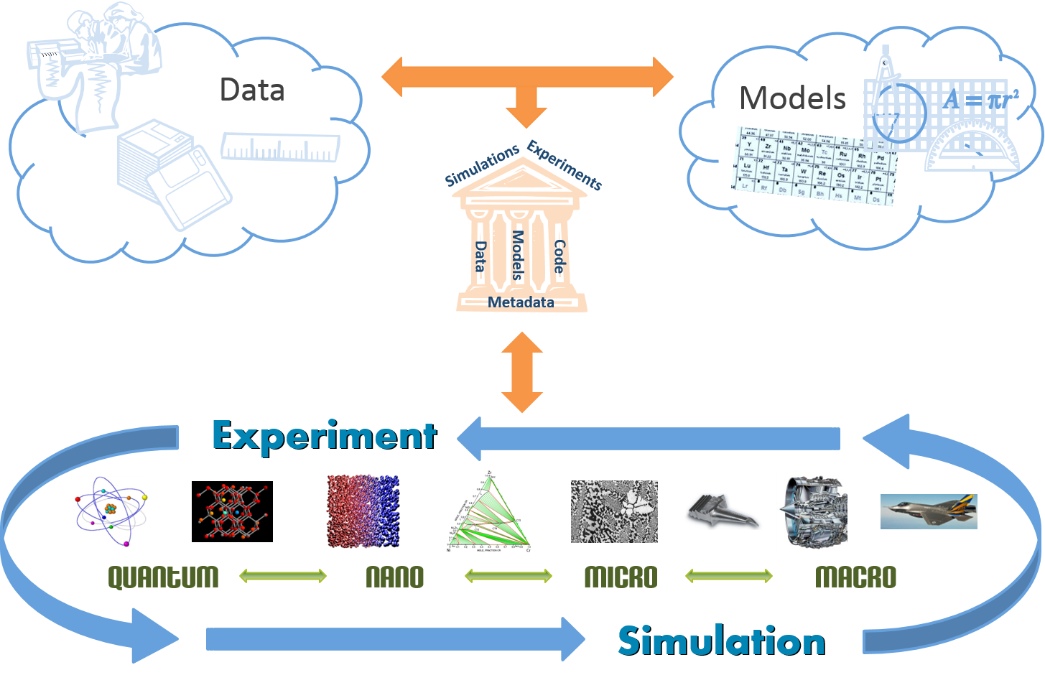
Materials data infrastructure
Data repository
Source: Jim Warren, NIST

Slide 36
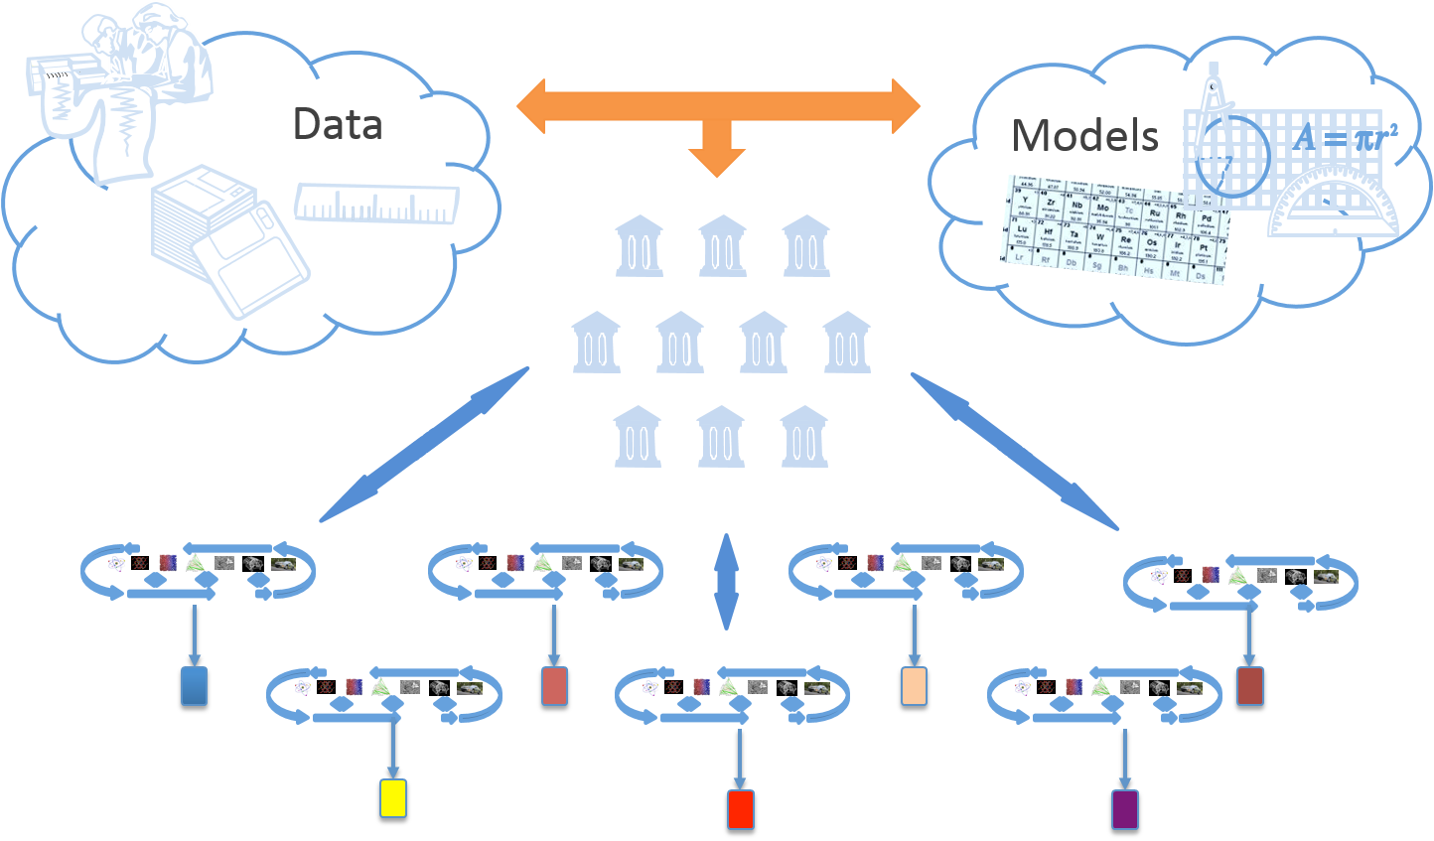
Materials data infrastructure
Open curated repositories
Source: Jim Warren, NIST

Slide 37
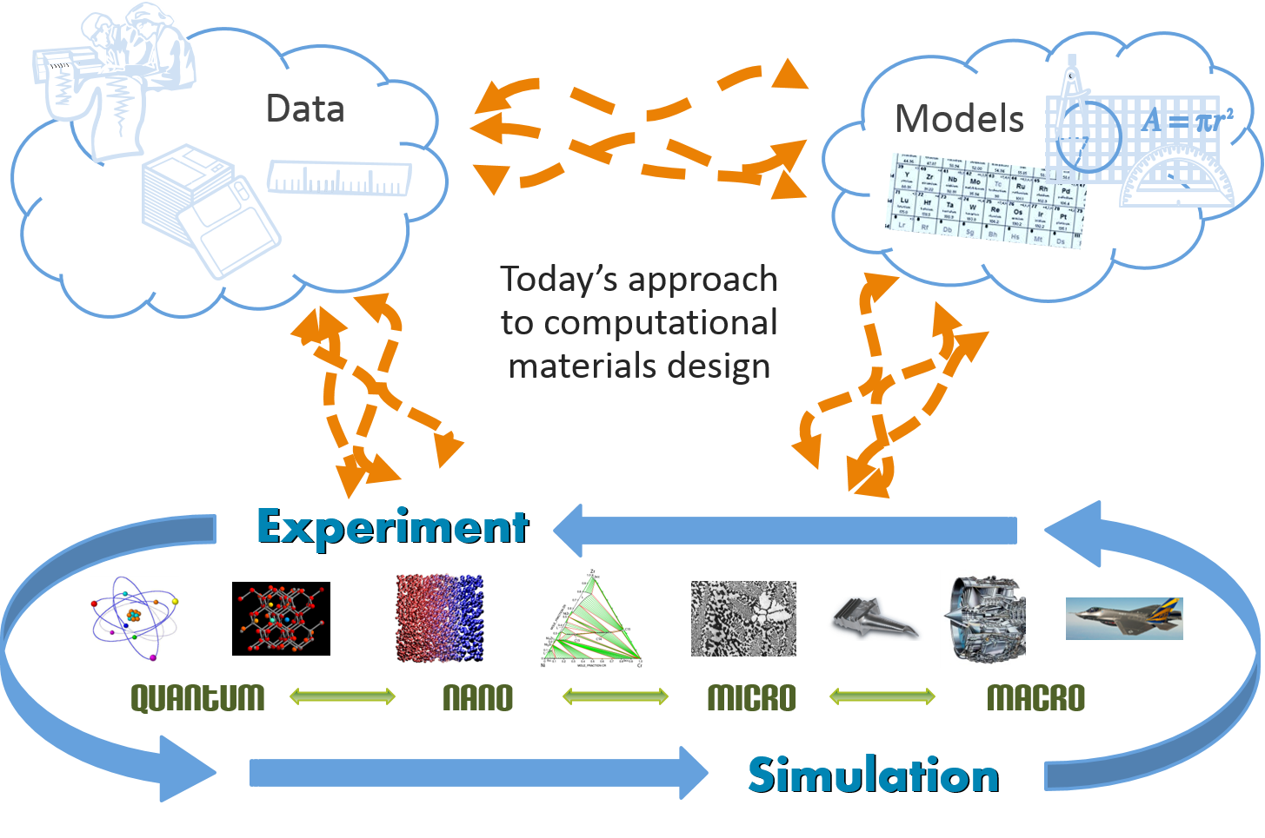
One thing in common
Source: Jim Warren, NIST

